Slide 1
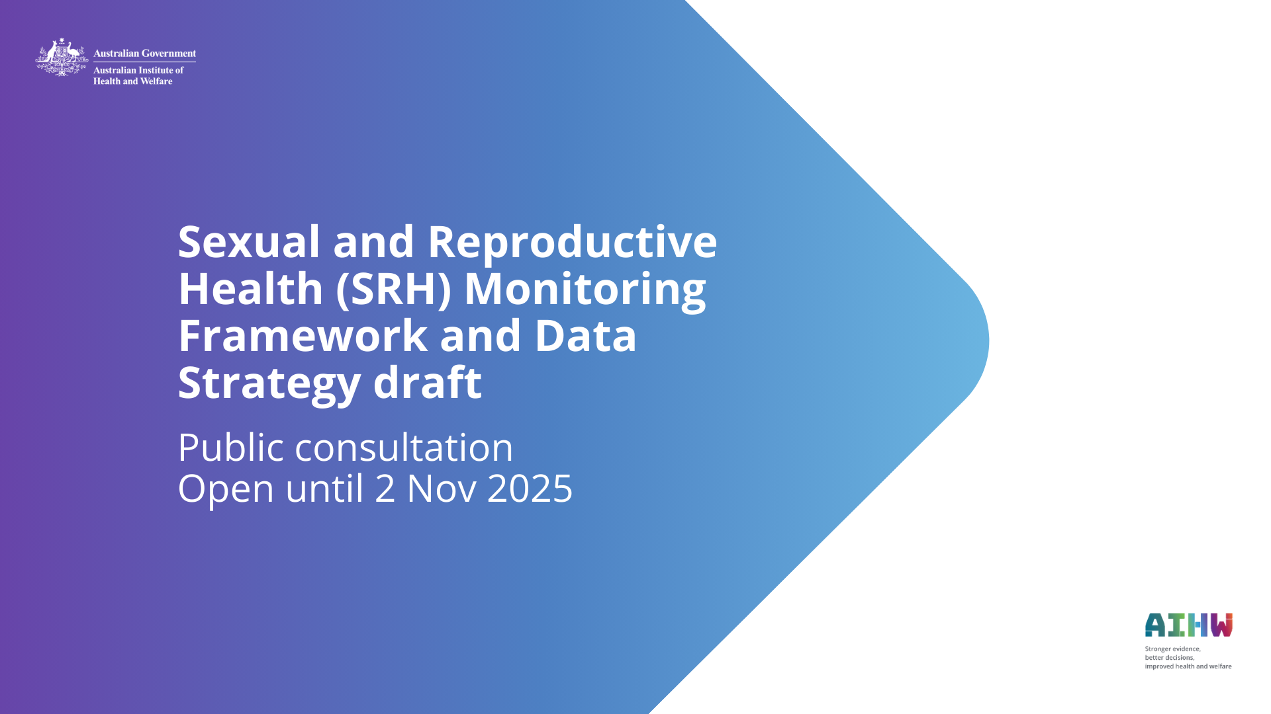
Notes:
Sexual and reproductive health is fundamental to health and wellbeing across every stage of life for all people in Australia. Despite this, there are gaps in national data, statistics, and monitoring information in Australia.
The Australian Government has funded the AIHW to develop a national sexual and reproductive health (SRH) monitoring framework (the framework), data strategy and regular reporting to fill these gaps. The goal is to ensure there is timely and reliable information about sexual and reproductive health and services in Australia to help plan and deliver high-quality SRH services and improve outcomes, including in relation to equity, access and quality.
This PowerPoint presentation summarises the draft SRH monitoring framework and data strategy document for public consultation.
Public consultation will be open until 2 November 2025, with feedback to be submitted via the online portal [LINK]). The AIHW will consider all submissions received.
Input is particularly sought on framework components and how they are arranged, including ensuring inclusivity and prioritisation of key elements, areas of measurement and data processes, data sources (existing and proposed), data stewardship, and guidance for ongoing stakeholder engagement.

Slide 2

Notes:
Introducing the SRH work plan
Improved health outcomes for all people in Australia will be gained by strengthening the evidence base that informs decision making in and for the health system. Accurate and responsive data is needed that makes visible the complex and evolving SRH concerns and priorities of diverse people within and between groups around the country.
Existing data is inadequate for effectively identifying and monitoring the evolving health needs for many in Australia. As part of the SRH data strategy and in reporting, the AIHW will work to develop and improve disaggregation categories.
Sexual and reproductive health is inclusive of many health issues experienced by people of all sexes and genders. Improved health outcomes for all people in Australia will be gained by ensuring the evidence base that informs decision making in and for the health system considers sex, gender, variations of sex characteristics and sexual orientation (NHMRC 2024). The standard for sex, gender, variations of sex characteristics and sexual orientation variables from the Australian Bureau of Statistics (ABS) standardises the collection and dissemination of data and will guide the data reporting and collection of the AIHW in relation to SRH (ABS 2021).
The AIHW recognises that the priority topics identified for the first phase of this workplan are focused primarily on SRH experiences typically associated with female sex characteristics.
For Aboriginal and Torres Strait Islander (First Nations) people, good health is more than the absence of disease or illness; it is a holistic concept that includes physical, social, emotional, cultural, and spiritual wellbeing, for both the individual and the community. This framework and data strategy seeks to reflect this and highlight SRH experiences of First Nations people, including in settings including Aboriginal Community Controlled Health Organisations (ACCHOs) and other health services. The AIHW already has trusted partnerships with First Nations communities, organisations and other stakeholders.
As processes and standards around SRH data collection and reporting are developed, the AIHW will strive to ensure that they reflect the diversity of people and their experiences of SRH accurately.

Slide 3
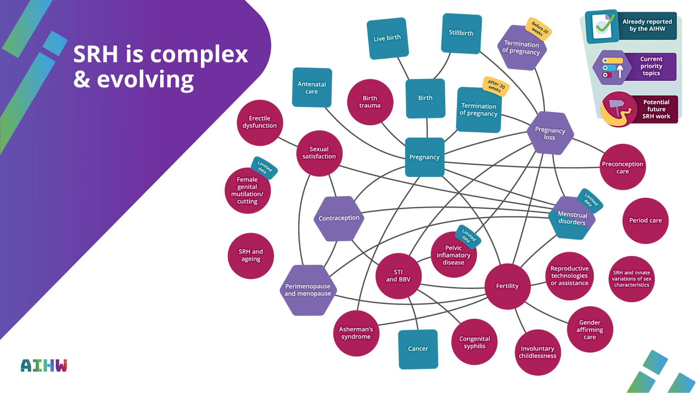
Notes:
SRH is complex and evolving
SRH across the life course encompasses a vast range of topics. A key component of the early stages of this project was therefore to define the scope of the work and identify initial priority topics in line with current policy priorities and with significant data gaps.
The framework was developed to apply across all areas of SRH; however, for the data strategy and initial reporting it was necessary to identify initial priority topics to focus data development activities on areas of current policy priority with significant information and data gaps. This was done through early stakeholder consultations and a review of relevant policy priorities and recent Senate inquiries.

Slide 4
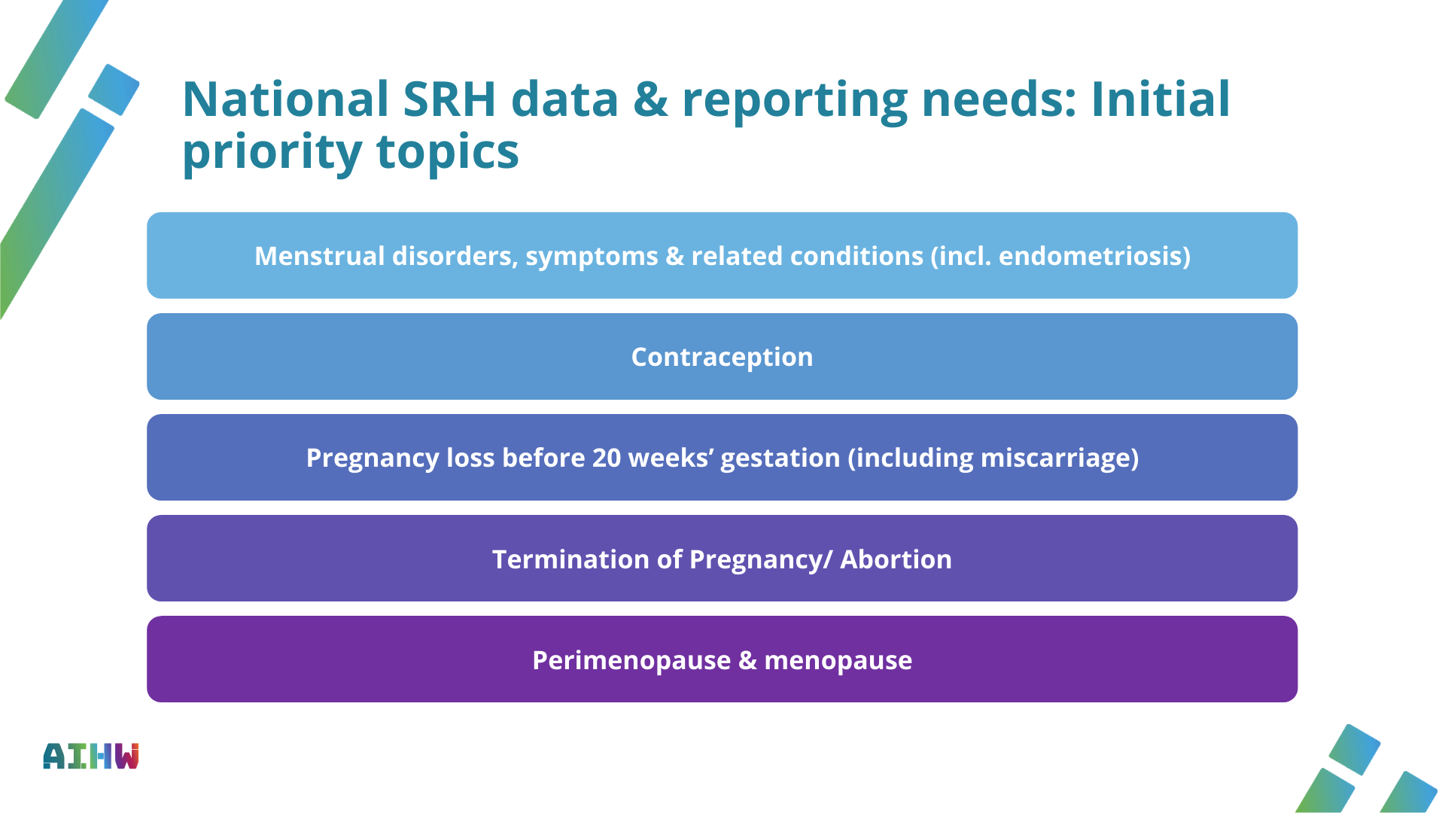
Notes:
This work has been directed toward five initial policy priority topics with significant data gaps:
* menstrual disorders, symptoms and related conditions (including endometriosis)
* contraception
* pregnancy loss before 20 weeks’ gestation (including miscarriage)
* termination of pregnancy, also known as abortion
* perimenopause and menopause.
Menstrual disorders, symptoms and related conditions includes menstrual disorders, some of their underlying causes, and associated symptoms. Menstrual disorders are disruptions related to the menstrual cycle such as heavy menstrual bleeding and painful periods. These can be due to underlying chronic conditions, such as endometriosis, or their cause may be unknown. People may also experience symptoms that are not only experienced during the menstrual cycle, such as pelvic pain, and may indicate an underlying condition.
Contraception, commonly known as ‘birth control’, or the act of preventing pregnancy using pharmaceutical, procedural or behavioural methods (Bansode et al. 2023). Contraceptives are used by people of diverse genders, sexes and ages to prevent pregnancy, manage hormones (for example, for management of menstrual disorders) and reduce risk of sexually transmitted infections (STI). Access to contraception, and contraceptive choice, is a critical component of universal access to SRH and realisation of reproductive autonomy.
Pregnancy loss is a common reproductive health experience that can have significant physical, emotional, and psychological impacts on all individuals involved in the pregnancy. For the purposes of this work program, pregnancy loss is defined as the unplanned loss of a pregnancy before 20 weeks’ gestation and includes miscarriage as well as other types of pregnancy loss.
Termination of pregnancy, also known as abortion, involves intentionally ending a pregnancy by removal of the embryo or foetus and placenta from the uterus, most often by taking medications or undergoing a surgical procedure (see Appendix G). Termination of pregnancy (TOP) has been decriminalised in all Australian jurisdictions, yet quality TOP care is not universally accessible (Community Affairs References Committee 2023; Vallury et al. 2023).
Menopause occurs when the reproductive capacity of a person ceases, signified by the absence of a menstrual period for one year. Menopause is preceded by perimenopause – a time characterised by changes in menstrual period frequency and regularity, the onset of oestrogen deficiency symptoms, and physical changes to the body and it’s functioning – which typically lasts 4 or more years (AMS 2022). Understandings of experiences, impacts and barriers to care are limited.
These health concerns interact across different stages of life and can have a significant impact on a person’s physical and mental health. Events occurring earlier in life, such as age at menarche, also impact on experiences later in life. For example, having the first menstrual period before 11 years of age is strongly associated with onset of menopause prior to age 45, endometriosis is associated with 1.8 times the rate of pregnancy loss compared with those without endometriosis, and people who have a history of recurrent pregnancy loss and/or stillbirth have a higher risk of experiencing premature or early menopause (Huang et al. 2020; Liang et al. 2023; Mishra et al. 2017). These events are also related to broader health issues such as infertility, chronic pain and poorer mental health.
These initial priority topics represent a starting point for the data strategy and reporting, with the intention to expand them over time to include other important areas of SRH.

Slide 5

Notes:
The framework and data strategy have been informed by a review of available literature, the current data landscape and consultation with a diverse range of stakeholders. These include Australian Government and state and territory government agencies, policymakers, researchers, service planners, service administrators, peak bodies and advocates, health-care providers, people with lived experience, and community/not-for-profit organisations. Consultations included workshops, one-on-one meetings and engagement with existing advisory groups and committees.
Topic overview reports were developed for each of the 5 initial priority topics. These included reviews of the literature and the data landscape, including data gaps. The stakeholder consultation process led to a refined list of critical data gaps and priorities for data development that have directly informed the development of the data strategy.

Slide 6

Notes:
Consultations and stakeholder engagement
The draft framework and data strategy have been informed by reviews of the literature and data landscape as well as initial stakeholder consultations.
These consultations have included Australian Government and state and territory government agencies, policymakers, researchers, service planners, service administrators, peak bodies and advocates, health-care providers, people with lived experience, and community/not-for-profit organisations. Consultations included workshops, one-on-one meetings and engagement with existing advisory groups and committees.
The AIHW has engaged with a broad range of stakeholders to inform development of the draft framework and data strategy. Broad and ongoing stakeholder engagement is central to ensuring that the framework and data strategy deliver data and information that meet the needs of stakeholders.
Throughout the consultation process, stakeholders acknowledged that there is a need for improved, systematic data collection on SRH throughout life for all people in Australia. Stakeholders expressed a need for data to better understand the current state of SRH in Australia, address barriers to access, shed light on people’s needs and experiences, and to improve policy, services and outcomes over time. Other cross-cutting issues raised by stakeholders in the consultations include:
Financial cost and inconvenience: the out-of-pocket costs and challenges of diagnosis and treatment can be very high, especially if people need to take time off work or travel away from their homes. Cost is anticipated to be a major barrier to access for people, and especially so for priority populations.
Workforce challenges, limitations and improvements: Stakeholders would like data to understand patient experiences within the SRH system, including qualitative data. There is also demand for data that measures workforce training in SRH, and ideally, tracks improvements in SRH literacy and competency – as well as scope of practice changes to increase workforce capacity.

Slide 7
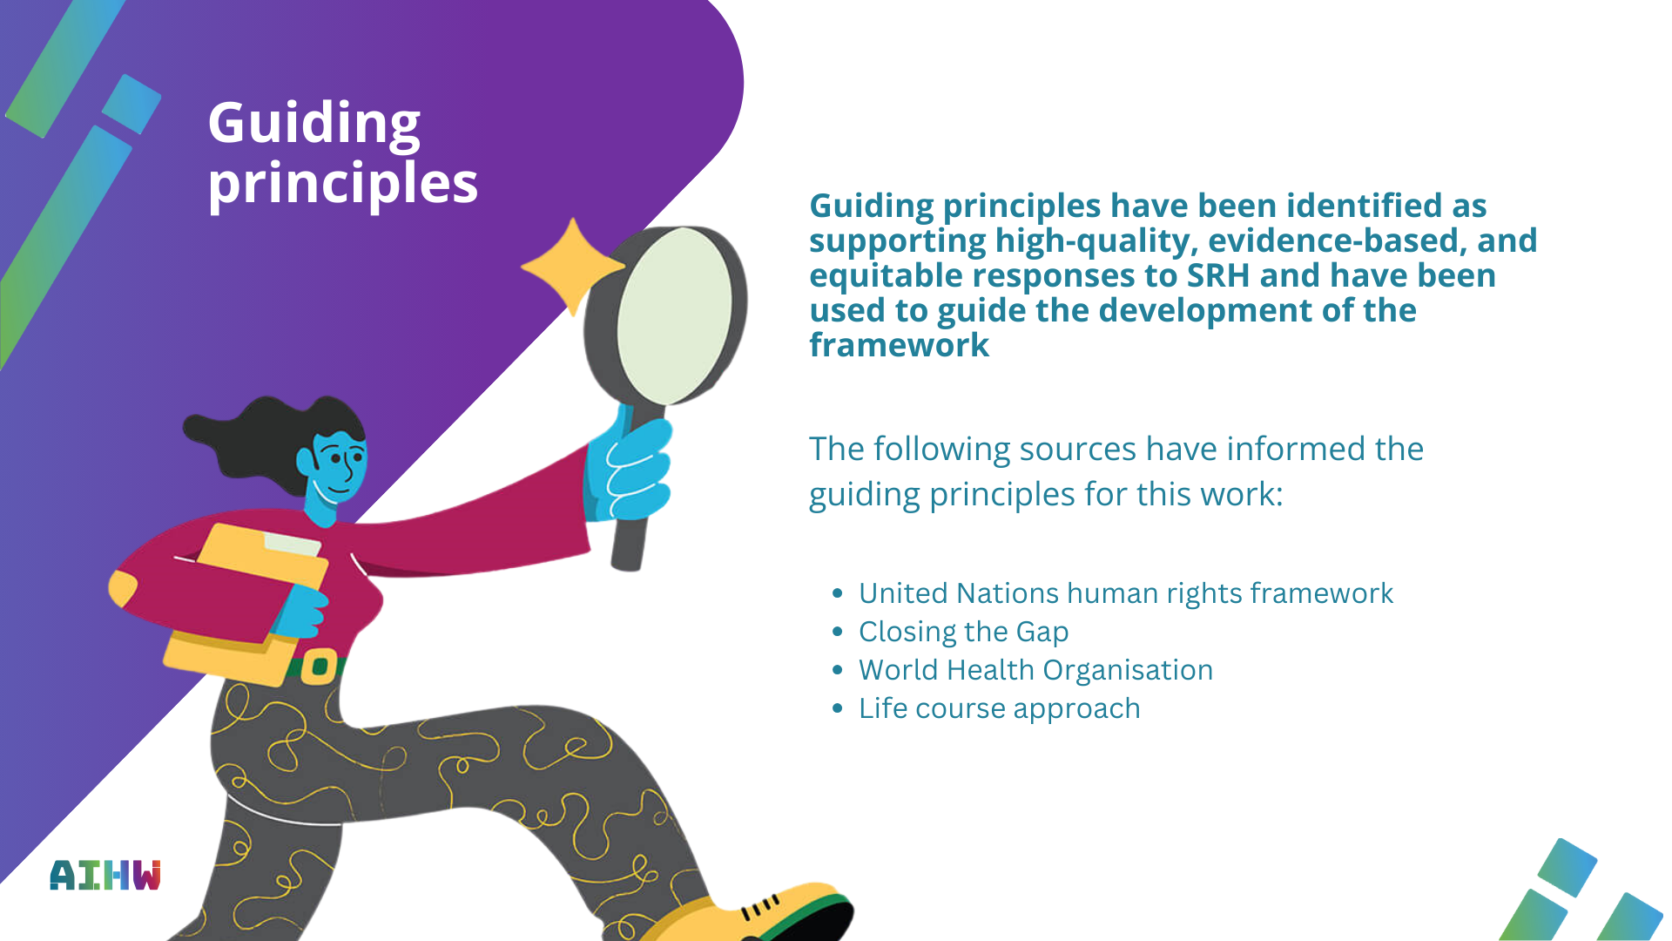
Notes:
Guiding principles have been identified as supporting high-quality, evidence-based, and equitable responses to SRH and have been used to guide the development of the framework:
* a human rights framework that acknowledges that all people have the right to enjoy the highest attainable standard of SRH, in line with rights to life, health, privacy, security, education, and freedom from discrimination and torture (OHCHR 2025; Melville and Corbin 2024).
* a person-centred and life course approach to monitoring that focuses on key aspects of who is and who is not experiencing sexual and reproductive health care and positive outcomes, and when.
* an approach that considers an understanding of health and well-being in relation to SRH conditions, including contributing to data to inform burden of disease estimates for SRH conditions.
* a focus on equity of SRH access and outcomes and service quality, beyond just ‘availability’.
"Equity is the absence of unfair, avoidable, or remediable differences among groups of people, whether those groups are defined socially, economically, demographically, geographically” (WHO 2025a).
* an approach that considers care delivered with the assistance and support of clinical guidelines, where confidentiality and privacy are trusted and assured, and service- and public-facing feedback mechanisms are functioning for quality improvement and accountability to stakeholders.
* a socio-ecological approach that enables measurement of, and exploration of interrelationships between, factors that influence SRH at individual, interpersonal, institutional and broader environmental and policy levels. This includes consideration of the contextual factors that shape SRH in Australia.
* an approach that complements and works alongside existing national and global SRH frameworks. The AIHW has aimed to develop a mechanism through which to supplement and fill gaps in existing frameworks, and to bring together priorities, indicators, research and data across the topic areas.
* an approach that considers outcomes of the National Agreement on Closing the Gap, including throughout implementation (Department of the Prime Minister and Cabinet 2020).

Slide 8

Notes:
Life course approach
Sexual and reproductive health and wellbeing evolve throughout the course of a person’s life. Taking a life course approach to developing SRH data involves recognising and measuring SRH experiences and access to health care throughout the different stages of development from birth to pre-puberty, to ageing and post-menopause. This approach allows for an understanding of sexual experiences and reproductive intentions and choices, risk, vulnerability, and physiological influences on health outcomes, as well as varying levels of access to health services and information across the course of their lives. A life course approach also means understanding how social, institutional and political contexts shape and gatekeep the pathways available to individuals (Baxter et al. 2022).
Developing a comprehensive understanding of SRH across the life course is critical for informing the timing and focus of health interventions, policies and services that maximise positive impacts on health. If done well, a life course perspective to data monitoring can facilitate understandings of optimal health trajectories, and critical life periods in which health measures and interventions have the greatest potential to impact health and wellbeing trajectories for different population groups (Burton-Jeangros et al. 2015). A life course perspective requires repeat measurements and benefits from data linkage processes.

Slide 9

Notes:
Diverse Australia and priority populations
Research and consultations identified that it is critical for the framework to facilitate improved understandings about the experiences of all Australians to inform policy and service-design that enables equitable SRH access and outcomes.
For each of the priority topics there are also a range of population groups who face additional barriers to SRH care, and experience poorer SRH outcomes. Additional groups may be identified in new or integrated data assets in the future. Existing data is inadequate for effectively identifying and monitoring the SRH needs and changes for people, within and between diverse population groups.
The reviews of literature and consultations identified that it is critical for the framework to facilitate improved understandings about these experiences. It is intended that data collected and reported against the framework will enable disaggregation by population, provider and service characteristics to the greatest extent possible. Recognising the intersectionality among different population groups is also central to understanding the complexity of these experiences. Acknowledging that disaggregation of existing data may not be immediately possible for all cohorts, improving the ability of data to be reported by priority groups will be a key focus of the data strategy, including for people who are (in alphabetical order):
~ Culturally and linguistically diverse, including recent migrants and refugees
~ Experiencing family, domestic and sexual violence and coercion
~ Experiencing socioeconomic disadvantage, including those not in education employment or training
~ First Nations people
~ Have innate variations of sex characteristics
~ Ineligible for Medicare, including those on temporary visas
~ Lesbian, Gay, Bisexual, and Queer
~ Living in closed settings, including prisons, detention centres and residential rehabilitation centres
~ Living in regional, rural and remote areas
~ Living in insecurity, including unstable housing or experiencing homelessness
~ Living with chronic and/or complex health needs, including people with disabilities and/or who are neurodivergent
~ Transgender and gender diverse
~ Transacting or selling sex and / or
~ Young people.

Slide 10
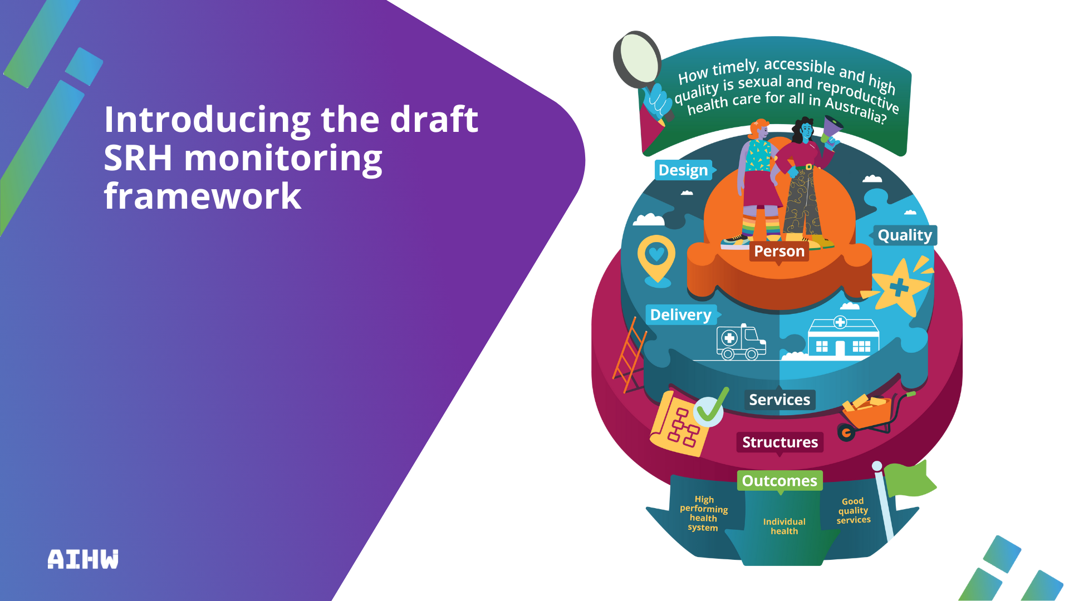
Notes:
Introducing the draft SRH monitoring framework
The framework provides a conceptual structure to understand and respond to critical SRH information in Australia.
The framework identifies what is important to monitor to:
* align with policy and stakeholder priorities
* inform evidence-based policy and service provision, and
* improve health-care outcomes throughout a person’s life, including equity and access.
The framework provides a conceptual structure for data collection and reporting that responds to the overarching question:
How timely, accessible and high-quality is sexual and reproductive health care for all in Australia?
The framework takes a person-centred, whole-of-life approach; focused on
* who is – and who is not – accessing sexual and reproductive healthcare when they need it
* what the barriers are to accessing SRH health care
* what the experiences are of those who do access care.
It looks at how equitable the design and delivery of sexual and reproductive health services are, the quality of services, and the contextual and systemic factors that shape SRH in Australia.

Slide 11
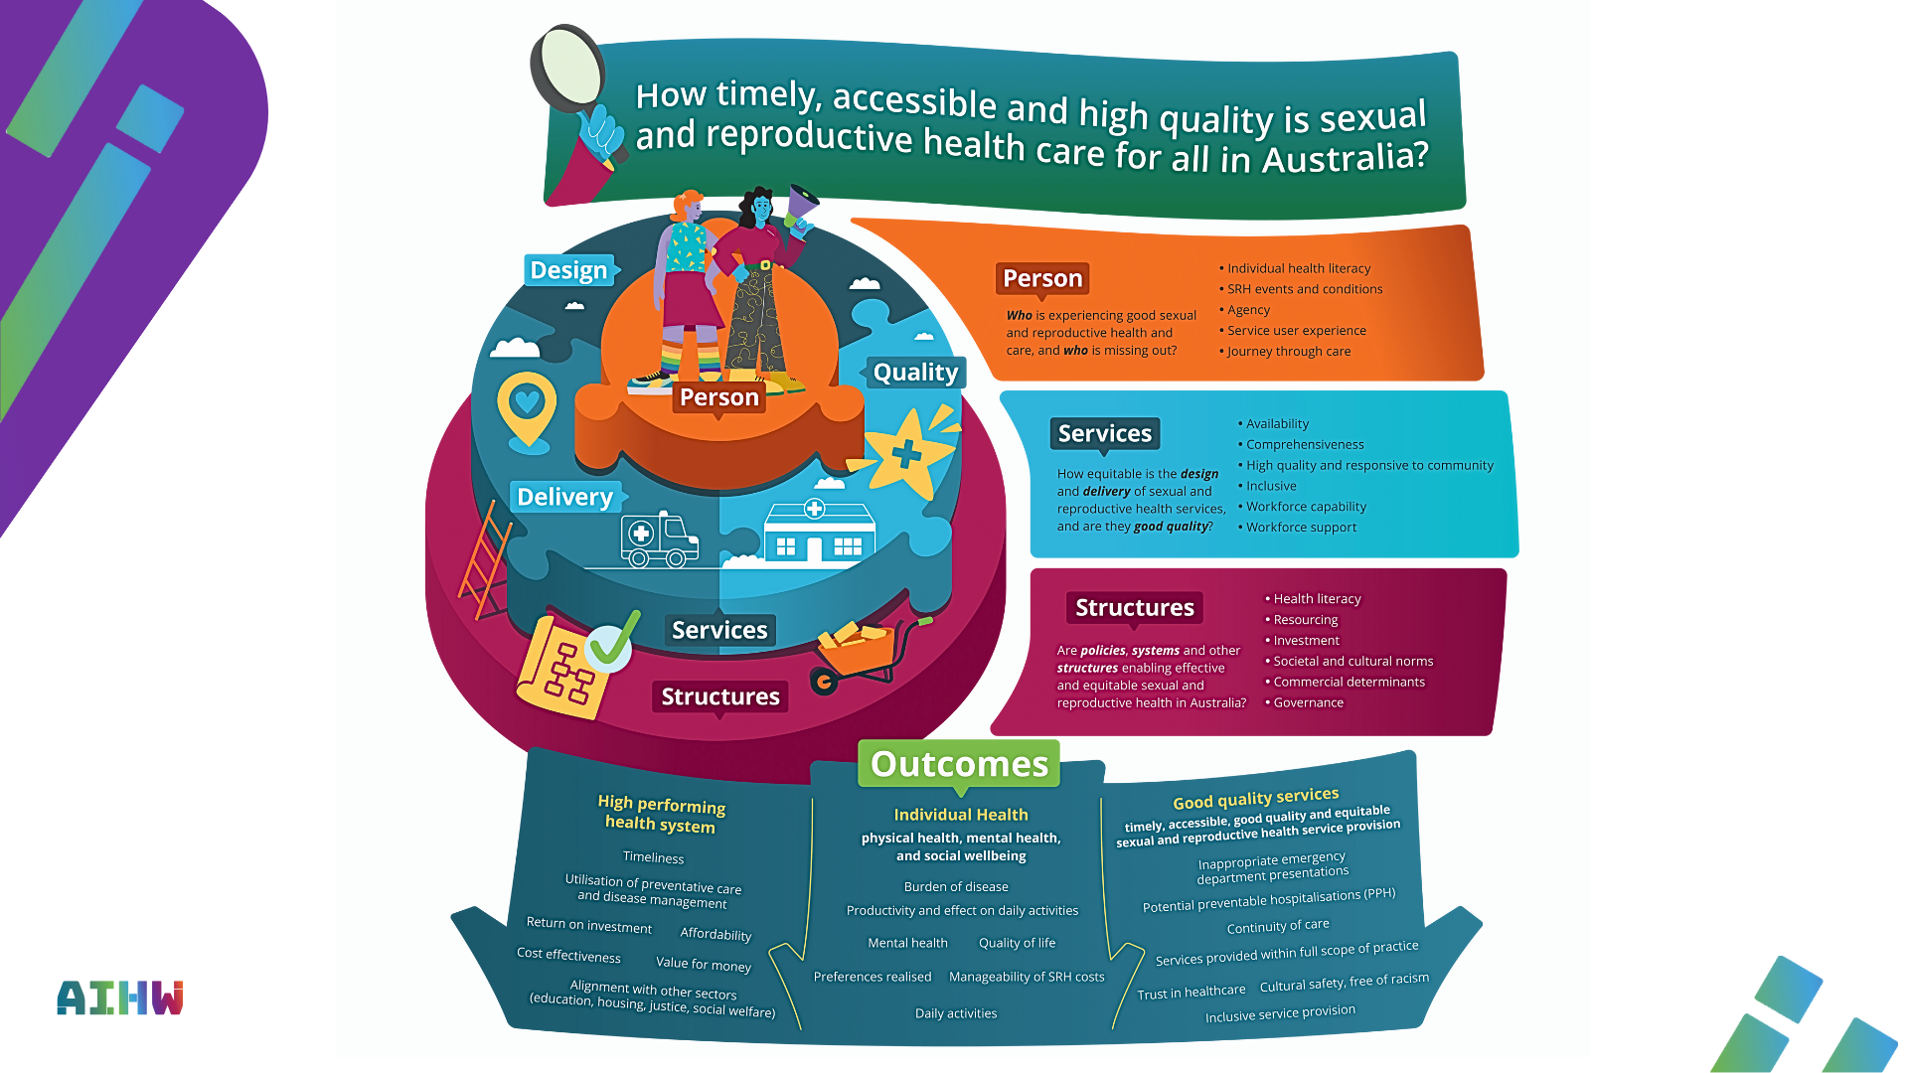
Notes:
The framework has been designed to apply to all areas of SRH, to support the addition of future priority topics. The approach taken aligns with international definitions and global health frameworks.
The framework lays out the key conceptual elements. The socio-ecological approach is illustrated in concentric layers, representing the contexts in which individuals’ access and experience SRH. The desired health outcomes are a result of actions that occur within and between these three levels
Within each level, the framework includes domains and sub-domains that reflect priority areas of potential measurement and monitoring of: SRH prevalence, determinants of SRH, equity, service design, delivery and quality, and experiences of care, and connects these to outcomes.
The domains and sub-domains are organised at the 3 levels of person, services, and structures and address 3 guiding questions:
Person: Who is experiencing good sexual and reproductive health and care, and who is missing out?
Services: How equitable is the design and delivery of sexual and reproductive health services, and are they of high-quality?
Structures: Are policies, systems and other structures enabling effective and equitable sexual and reproductive healthcare in Australia?

Slide 12
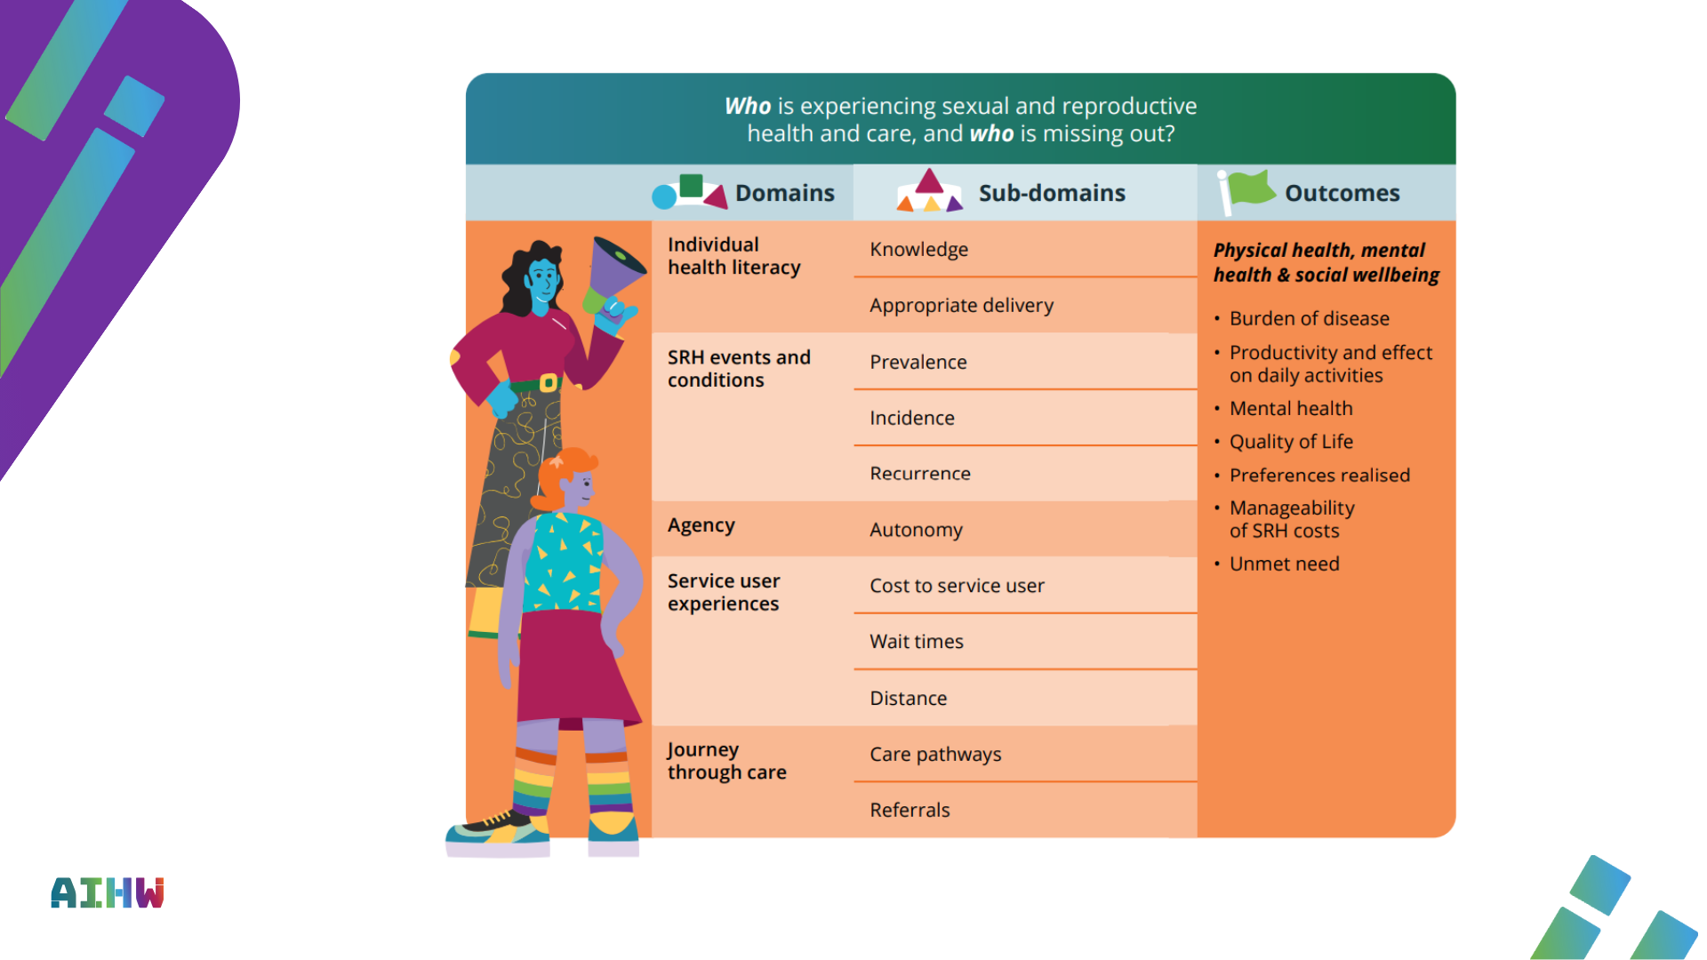
Notes:
Person level of the socio-ecological framework
Who is experiencing high-quality sexual and reproductive health and care, and who is missing out?
The first part of the framework focuses on monitoring SRH care and outcomes by identifying who is and is not experiencing good SRH. Areas of measurement to assess good SRH could include if it is timely, free from stigma, and results in a positive or desired outcome. Individual (intrapersonal) and interpersonal determinants are the focus, including characteristics and experiences of people that relate to their experiences of SRH, and outcomes relate to physical and mental health and social wellbeing of a person. People live within families, communities and the wider society - their personal circumstances can impact their behaviours and ability to exercise agency and autonomy in general and in relation to SRH. Data in this part of the framework would be collected, analysed and reported by cohorts of people to make visible who is and is not experiencing good sexual and reproductive health around Australia.

Slide 13
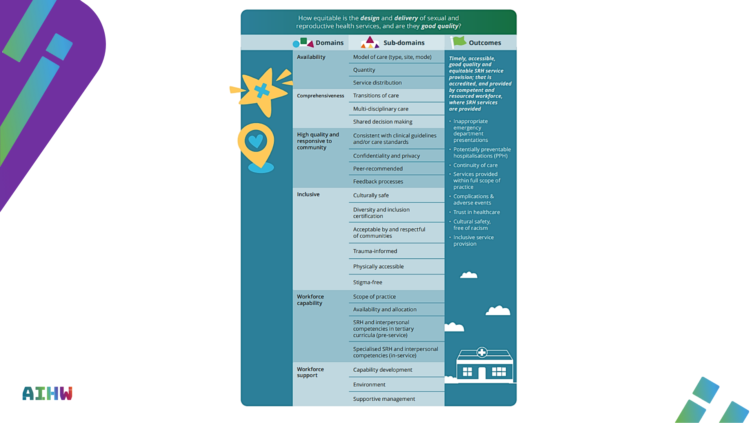
Notes:
Services level of the socio-ecological framework
How equitable is the design and delivery of sexual and reproductive health services, and are they high-quality?
This level of the framework focuses on monitoring the design and delivery of SRH services, with a focus on the extent to which they are equitable and of high-quality. Areas of measurement to assess this could include considering if people are accessing the right services, the nature and type or interpersonal interactions between people and health care providers, and if the care pathways are desirable and efficient and reaching those who need them. Outcomes at this level include aspects of workforce support and capacity, accreditation and inclusivity, and physical and cultural safety.

Slide 14
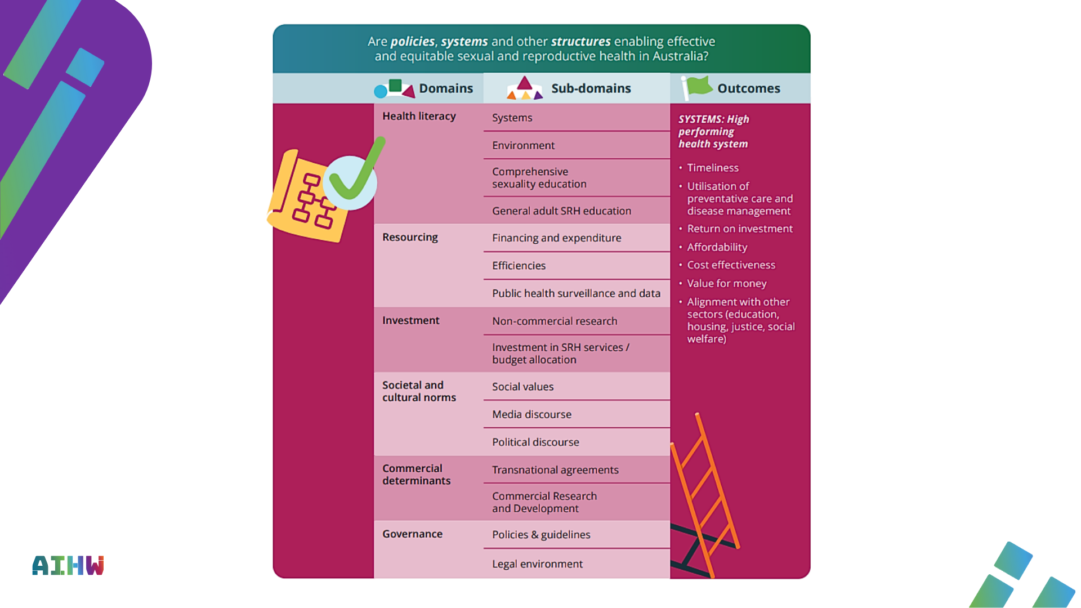
Notes:
Structures level of the socio-ecological framework
Are policies, systems and other structures enabling effective, equitable and high-quality sexual and reproductive health in Australia?
This level of the framework considers measurement and monitoring of health and other policies, systems and structures that influence the accessibility and effectiveness of SRH care and equity of SRH outcomes. This includes societal, cultural, and religious values as well as other structural determinants of health. For example, the Organisation for Economic Co-operation and Development has highlighted the need to measure the legal and social context in which SRH is situated (OECD 2025). At the systems level, outcomes that aid in assessment of health system performance were identified and where relevant are aligned with those proposed in the draft Australian Health Performance Framework (AHPF) framework.

Slide 15

Notes:
The data strategy sets out a plan to collect and report reliable and timely SRH data. It proposes to improve the quality and availability of SRH information in three ways:
1 Maximising use of existing data collections: through enhanced analysis and data linkage and undertake more complex analysis and bespoke analytical projects.
2 Enhancing existing or planned data collections: by collaborating with owners of existing data collections to add questions or modules to existing surveys, develop consistent data standards, or improve data extraction from existing systems (for example, in primary care).
3 Options for new data collections: establishing a new collection, or standardising and collating existing data where insufficient data exists or where further data development of existing sources is not feasible. The following options have been proposed:
* National sexual and reproductive health survey: a potential new ongoing national sexual and reproductive health survey would help address many gaps.
* National register on pregnancy loss before 20 weeks’ gestation: a national register on pregnancy loss would improve information on people experiencing pregnancy loss who require health care.
* Workforce survey and/or skills and practice audit: an SRH workforce survey and/or skills and practice audit could fill a range of data gaps on the capacity and capability of the SRH workforce and services.
* Pharmacy data collection: an ongoing SRH pharmacy data collection including PBS-subsidised and private/non-subsidised scripts would support monitoring of use, affordability and geographic accessibility of SRH-related medications over time.
* Service data collection: an aggregate service-level data collection collating measures such as services provided and the reason for provision.
The data strategy and the framework are expected to support additional priority topics in the future and evolve to reflect the dynamic nature of SRH for all people in Australia and changing stakeholder information needs.
The focus of this work is on addressing gaps in information and data and to not duplicate work currently being undertaken or in development. The AIHW notes that emerging data sources will require continual monitoring to ensure that the proposed data strategies remain relevant and do not duplicate effort.
Priority populations and disaggregation
The AIHW will aim to develop data collections and report data that includes geographical disaggregation, as well as, wherever possible, ensuring data can be used to identify population groups who are currently underserved by or experiencing particularly salient barriers to access to SRH care.
Data governance
As the data strategy is implemented, the AIHW is aware of ensuring appropriate data governance and privacy protections are embedded at all stages of the process.
This includes ensuring compliance with the Privacy Act 1988 (Cwlth), confidentiality provisions in the Australian Institute of Health and Welfare Act 1987 (Cwlth), and other relevant state and territory and Commonwealth legislation to ensure the protection of privacy, and confidentiality, and appropriate safeguards of the data. The use of the Five Safes framework will also reinforce management of the privacy and confidentiality of data.

Slide 16

Notes:
After the public consultation, the AIHW will finalise the framework and strategy by the end of 2025.
The following phase of this work will focus on data development activities and developing regular reporting mechanisms in relation to the initial priority topics. The first annual report will be released publicly in mid-2026.

Slide 17
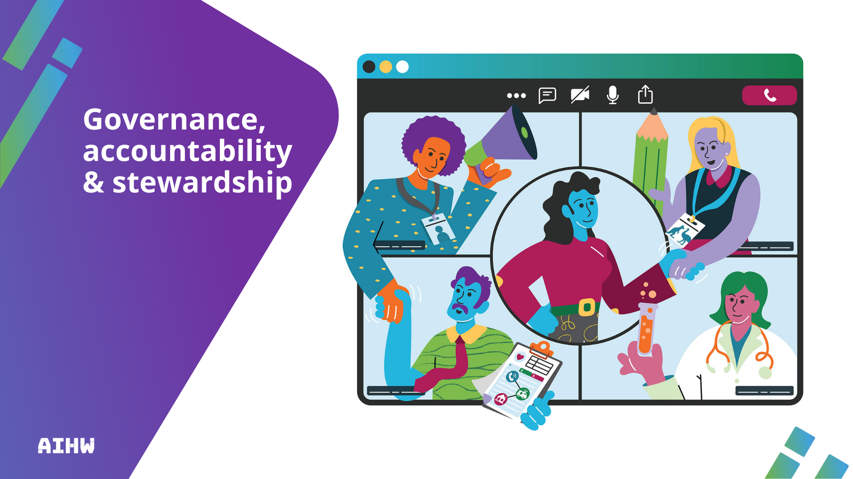
Notes:
The AIHW is a strong strategic partner that works with a broad range of stakeholders. Partnership and collaboration are cornerstones of the framework and data strategy, and this work will be supported through governance and advisory committees.
Current governance and advisory arrangements
Current governance and advisory processes that have been established for this work include:
SRH Steering Committee: oversees the work program and provides advice on the strategic directions of the project, governance, key project deliverables, milestones and other planning matters to ensure appropriate processes and consultation steps are undertaken and the work delivered is of high-quality. Membership of the Steering Committee consists of the AIHW and the Australian Government Department of Health, Disability and Ageing.
National Miscarriage Expert Advisory Group: provides clinical and technical expert advice regarding data needs, sources, gaps and opportunities, and definitions related to pregnancy loss (including miscarriage) for the purposes of national data collection. Terms of reference and membership are available on the AIHW website: National Miscarriage Expert Advisory Group.
Future governance and ongoing engagement
Following the finalisation of the framework and data strategy, it is anticipated that ongoing advisory arrangements will be required to advise and inform the implementation of the framework, data strategy and the development of reporting. It is anticipated that this will include a diverse range of stakeholders and data providers and include ongoing community engagement.
These arrangements will be established once the framework and data strategy are finalised to ensure they reflect the final documents following public consultation.
Given the differences in health services governance, structures, and models of care across Australia, the way health data is entered, collected, and interpreted may be challenging to assimilate. Engagement with jurisdiction health departments, Primary Health Networks and other providers of SRH services will be crucial to inform and facilitate SRH data development and ensure reporting mechanisms are appropriate and fit-for-purpose for end-users.
As noted in section 1, the AIHW is committed to the implementation of the Framework for Governance of Indigenous Data including the 4 guiding principles outlined below as well as ensuring that our commitments to the 4 Priority Reforms under the 2020 National Agreement on Closing the Gap are realised in implementing the framework and data strategy (NIAA 2024; NIAA 2020).
Ongoing stakeholder and community engagement across the data lifecycle will guide AIHW’s implementation of the SRH work program, by:
partnering with communities, including First Nations people and other priority populations,
* building data-related capabilities with and for key stakeholders,
* providing knowledge of data assets, and
*building an inclusive data system.
The AIHW will establish additional trust-based partnerships and work with communities and key stakeholders to implement the framework and data strategy, promoting and developing meaningful engagement processes that include people with lived experience.
The AIHW welcomes guidance through this consultation process on data stewardship and guidance for ongoing stakeholder engagement to ensure rigour, accuracy and inclusivity in our measurement and reporting data about access and equity to SRH in Australia.

Slide 18

Notes:
Public consultation is a valuable and important opportunity to help shape the direction of the framework and strategy.
The public consultation will be open until 2 November 2025 and feedback can be submitted via the online portal [LINK]. The AIHW will consider all submissions received.
Feedback is particularly sought on:
* The framework components and how they are arranged, including ensuring inclusivity and prioritisation of key elements
* Areas of measurement and data processes proposed in the data strategy
* Data sources (existing and in development) that could be included in reporting under the framework and strategy
* Data stewardship and guidance for ongoing stakeholder engagement to support the process.
Some questions to consider for specific feedback include:
* How well do you think this draft framework and data strategy will address your SRH data questions/needs?
* What are your recommendations for future priority areas of focus?
* How easy was it to understand the draft framework and data strategy, and why?
* How clear are the overall goals and proposed actions of the draft framework and data strategy respectively?
* Please suggest alternatives if improvements are needed for specific terminology in the draft framework and data strategy
After the public consultation, the AIHW will finalise the framework and strategy. The next phase will focus on data development activities and developing regular reporting mechanisms. The first annual report will be released publicly in mid-2026.

