Slide 1

Getting to know the
National Health Data Hub
AIHW Webinar
June 2025

Slide 2



Slide 3


Funding partners

Slide 4
About the AIHW
Overview of the NHDH
How the NHDH fits into the data linkage landscape
Designing your research
Applying for access
NHDH+n project model
Key messages
Questions
Contents

Slide 5
With more than 37 years’ experience,
the Australian Institute of Health and Welfare (AIHW)
is Australia’s authoritative source of health and welfare data and analysis.
With more than 37 years’ experience,
the Australian Institute of Health and Welfare (AIHW)
is Australia’s authoritative source of health and welfare data and analysis.
About the AIHW

Slide 6
What we do
We collect, manage, analyse and report on a wide range of health and welfare data topics.
Injury
Child protection
Chronic diseases
Housing
Health expenditure
First Nations people
Mental health
Mortality
Mothers and babies
Alcohol and other drugs
Disability
Hospitals
Justice and safety
Homelessness
Social determinants
Ageing and aged care

Slide 7
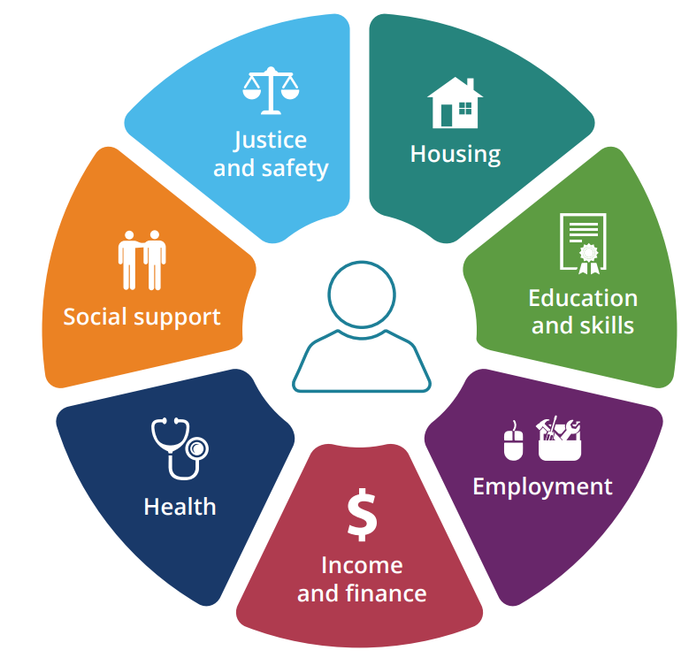
We join the dots
In addition to reporting data on individual topics, we link data on a range of topics to offer new insights.
We use a ‘person-centred’ model for
reporting data.

Slide 8
Australia’s linkage beginnings
1980s
Cancer Statistics Clearing House was established by the AIHW to provide national cancer information.
2022​
The AIHW established a national, linked register and research data set to support research into the health effects of COVID-19.
​
2009
Population Health Research Network (PHRN) was established to support cross jurisdictional linkages and provide a national picture.
2017-2020
Data integration partnership for Australia (DIPA)
2018
National Integrated Health Service (NIHSI)
​
1970s
A pilot record linkage scheme in Western Australia was the first step in building Australia’s national linkage system.
1995
The Western Australia Data Linkage System was established as a system of linkages within and between health and non-health data collections in WA.
2015​
The AIHW established linkage methodology for a range of health data sets based on the Medicare Consumer Directory data​.
​
2017
National Master Linkage Key
2020
National Disability Data Asset (NDDA) pilot commenced to give a more complete picture of the life experiences of people with disability.
2024​
National Primary and Acute Care linkage design phase commenced to gain a better understanding
of patient’s journey
and experiences
​

Slide 9
Data Linkage Challenges
Patchwork of project specific approaches.
Different legal basis, sharing approaches and governance for data assets.
Significant resourcing and funding constraints
Duplication of effort and long lead times for linked data
A proliferation of data heightening security risks.
Scattered efforts, reducing the overall capacity for data insights to inform policy decisions and program development.

Slide 10
With more than 37 years’ experience,
the Australian Institute of Health and Welfare (AIHW)
is Australia’s authoritative source of health and welfare data and analysis.
National Health Data Hub
Unlocking the power of linked
health and welfare data
for all Australians

Slide 11
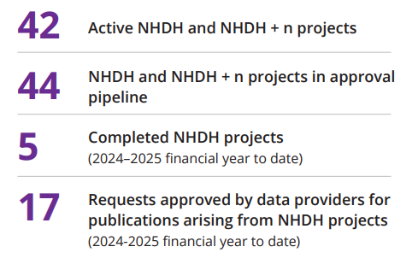
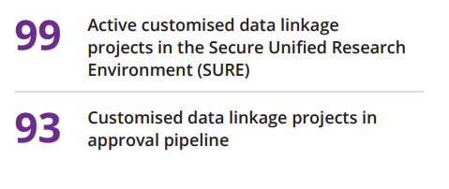
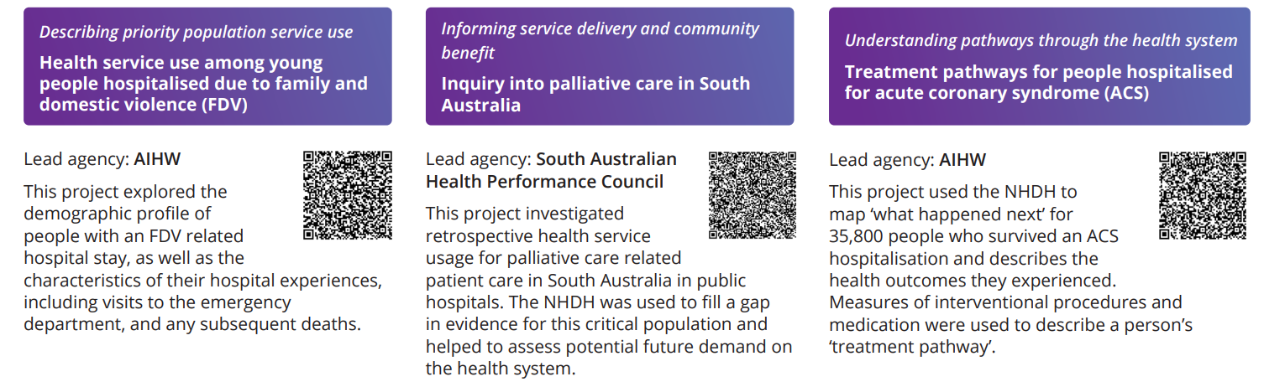
AIHW data linkage offerings
National Health Data Hub (NHDH)
Access to modules within the NHDH – a national de-identified linked data system that draws together core government data sets
NHDH + n
Linking additional data set/s to the NHDH under project-specific governance
Customised data linkage
Ad-hoc linkage of a customised set of data for a project-specific purpose

Slide 12
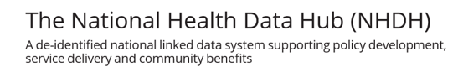
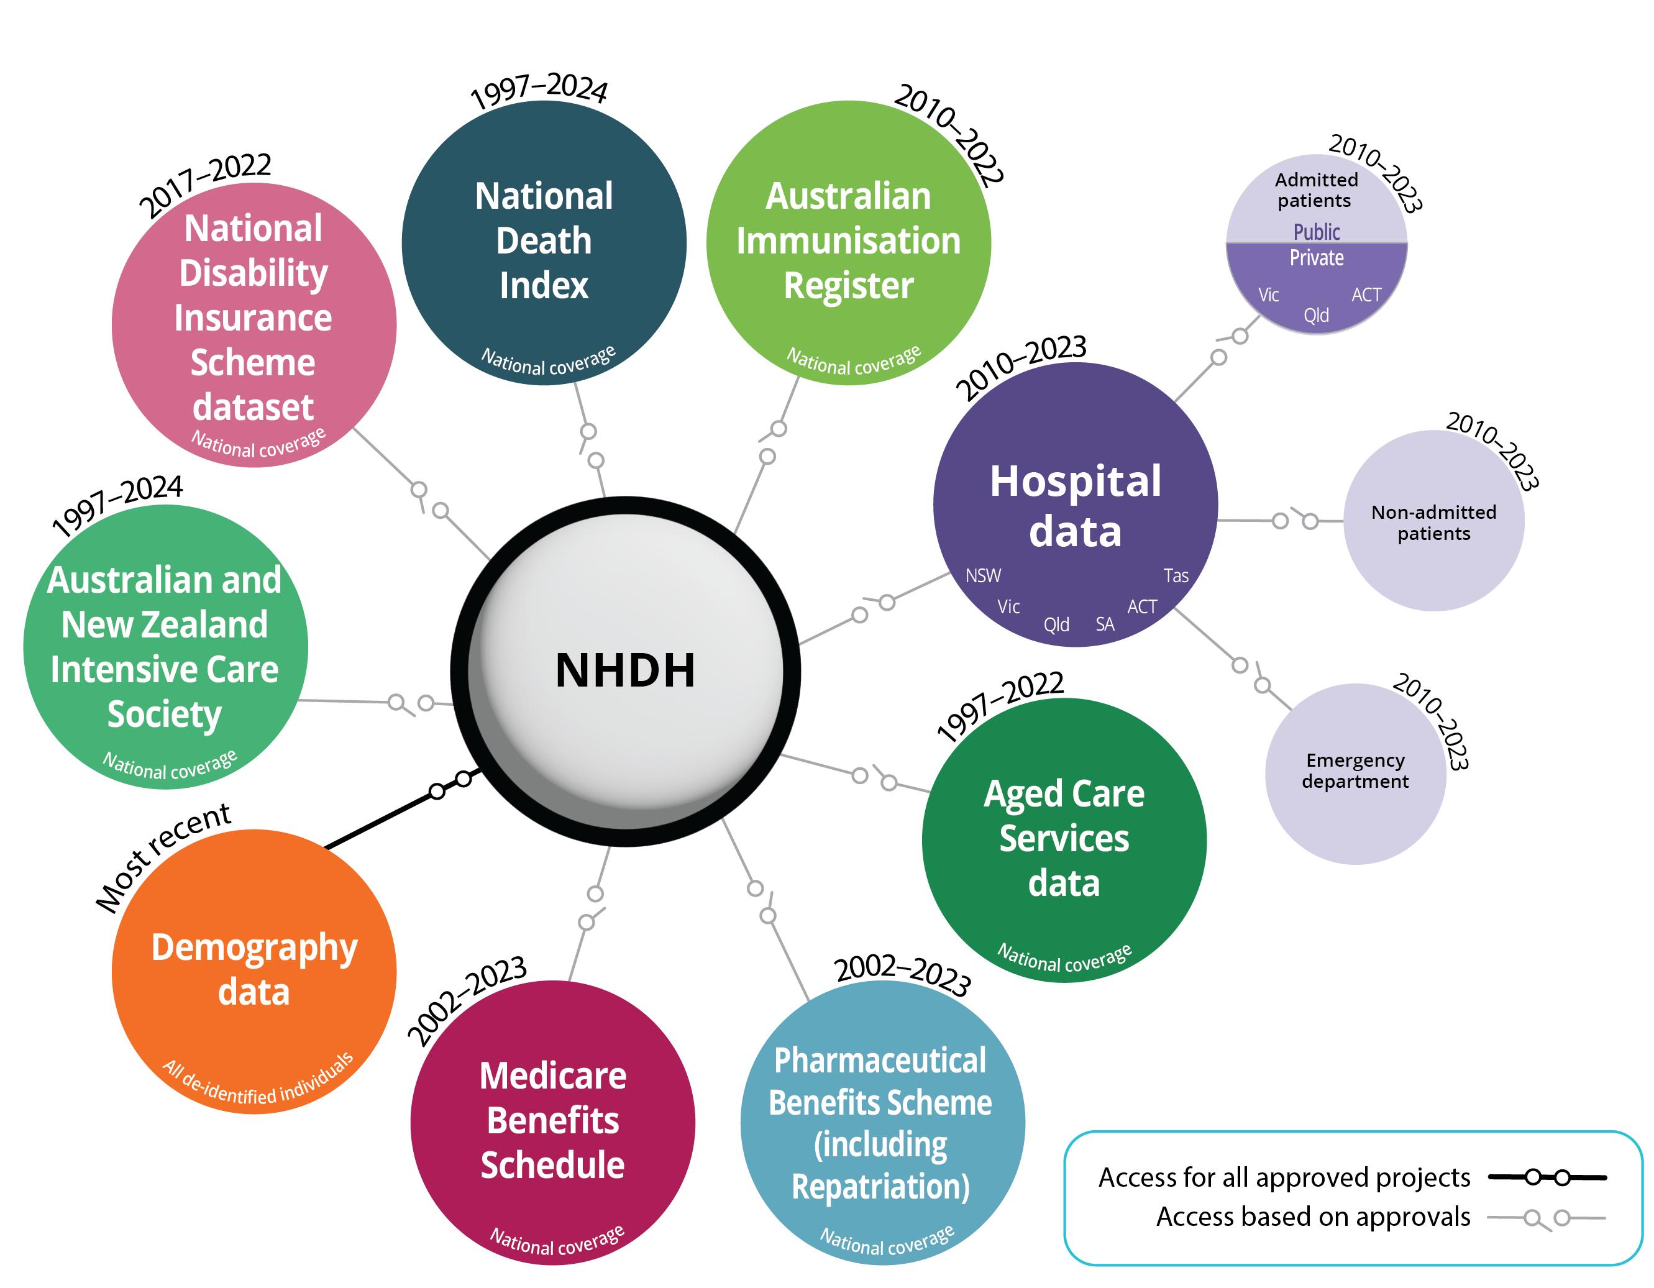
National Health Data Hub
Coming soon
National Community Mental Health Care Database
National Residential Mental Health Care Database
National Perinatal Data Collection
Specialist Homelessness Services Collection
Child Protection National Minimum Dataset
Australian Early Development Census (AEDC)
National Cancer Screening Register Data Collection
Australian Cancer Database (ACD)
National Diabetes Services Scheme (NDSS)
COVID-19 case data from the National Notifiable Diseases Surveillance System (NNDSS)
Generation Victoria (GenV) birth and parent cohort study.
Various Clinical Quality Registers

Slide 13
Guiding principles for the development of the NHDH
Privacy by design
Minimise the need to share and use personal information
Share once and use many times
Employ efficient methodologies and processes
Adoption of a distributed interoperable linkage model with state and territory data linkage units linking to a common spine (based on the Medicare Consumer Directory) and sharing through de-identified maps.

Slide 14
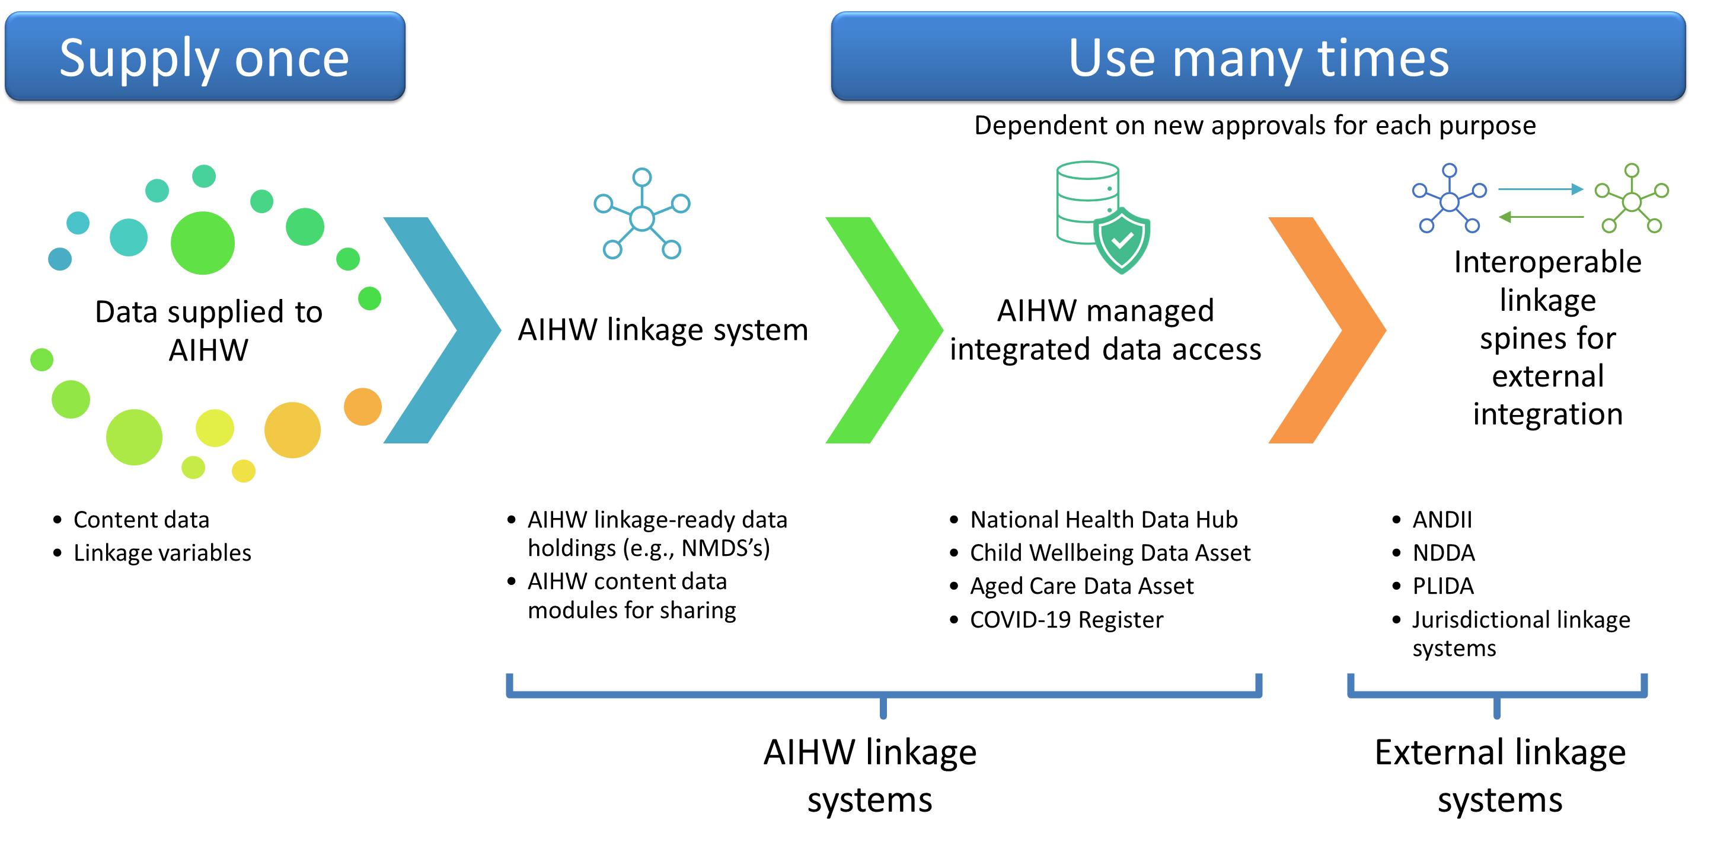
Data flow concept

Slide 15
Principles of NHDH design
Benefits of the NHDH
Delivers:
  Better coverage and expansion of data
  Access to non-government researchers
  Reduced duplication of effort and costs
  Improved time frames for access to data
  More efficient and safer data sharing
  Improved timeliness of data
  Streamlined governance arrangements, including acceptance of programs of work
  Flexible and responsive to emerging issues
  Greater interoperability between State and Territory linkage nodes and existing linked data assets such as PLIDA and NDDA
  Enabling two-way data flows, and other data sharing initiatives (e.g. NMLK)
  Scalability and gradual expansion of content.
Delivers:
  Better coverage and expansion of data
  Access to non-government researchers
  Reduced duplication of effort and costs
  Improved time frames for access to data
  More efficient and safer data sharing
  Improved timeliness of data
  Streamlined governance arrangements, including acceptance of programs of work
  Flexible and responsive to emerging issues
  Greater interoperability between State and Territory linkage nodes and existing linked data assets such as PLIDA and NDDA
  Enabling two-way data flows, and other data sharing initiatives (e.g. NMLK)
  Scalability and gradual expansion of content.
Delivers:
  Better coverage and expansion of data
  Access to non-government researchers
  Reduced duplication of effort and costs
  Improved time frames for access to data
  More efficient and safer data sharing
  Improved timeliness of data
  Streamlined governance arrangements, including acceptance of programs of work
  Flexible and responsive to emerging issues
  Greater interoperability between State and Territory linkage nodes and existing linked data assets such as PLIDA and NDDA
  Enabling two-way data flows, and other data sharing initiatives (e.g. NMLK)
  Scalability and gradual expansion of content.

Slide 16
How the NHDH fits into the data linkage landscape
Unlocking the power of linked
health and welfare data
for all Australians

Slide 17
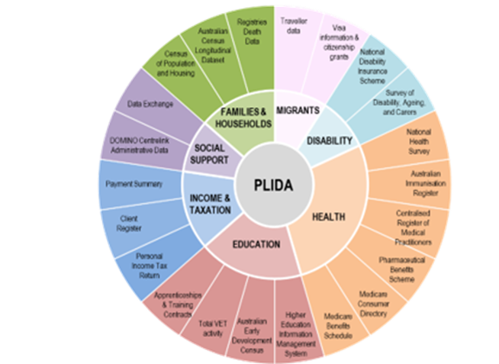
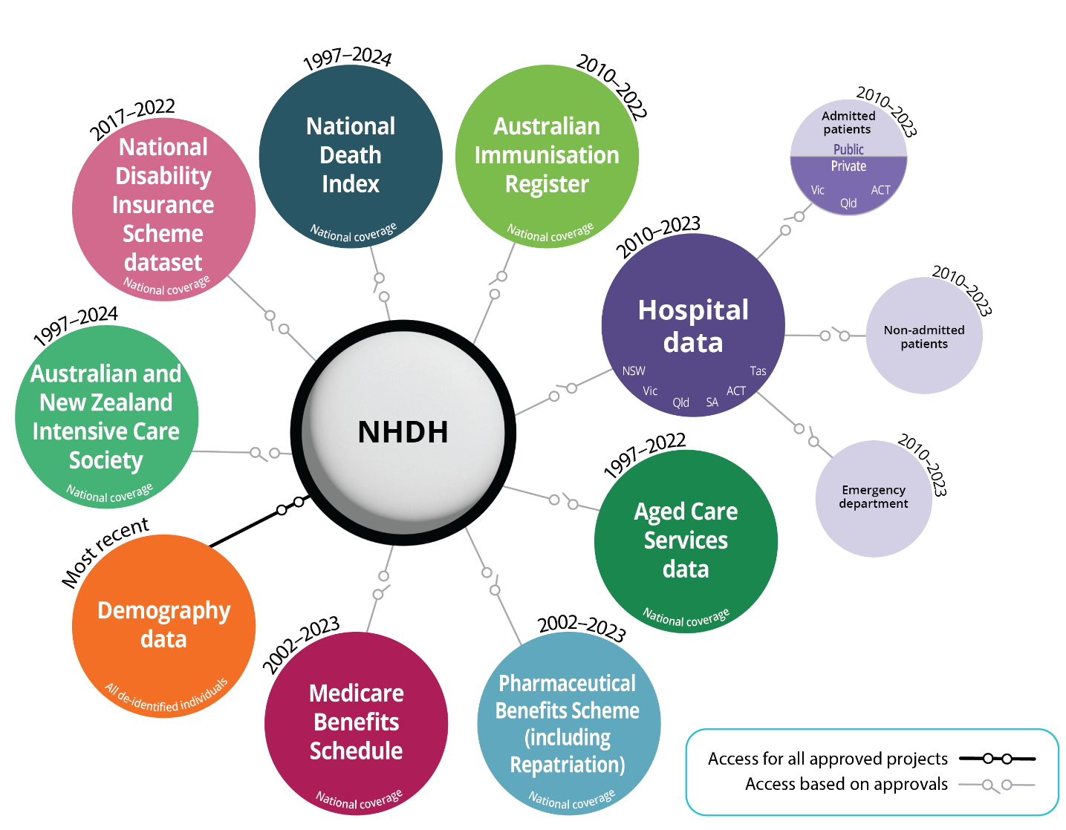






Overview of the data linkage landscape
Key players in national data linkage system
ABS
AIHW
Jurisdictions (incl. PHRN)
Person-Level Integrated Data Asset (ex-MADIP)
National Health Data Hub (ex-NIHSI) and AIHW Linkage System
State and territory data linkage units supporting data assets and delivering bespoke data linkage projects
Supported by
National co-governance of system
Interoperable spines as part of a National Linkage Model
Streamlined data sharing for multiple purposes
Enabling ICT for safe, secure and scalable approaches
Co-governance of domain specific use of data

Slide 18

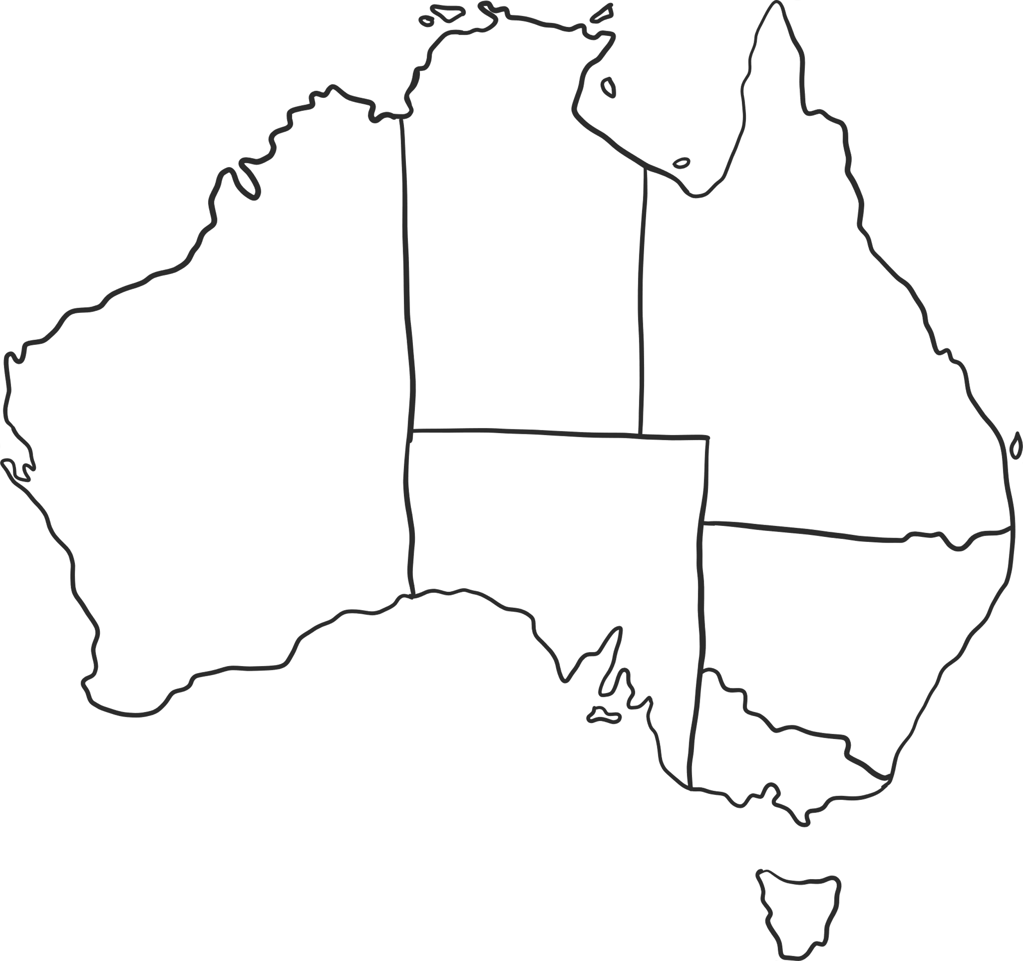










Population Health Research Network
304
Accessible Datasets
Working together in partnership
3,184
Live & completed projects​
2,285 Publications

Slide 19
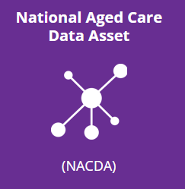
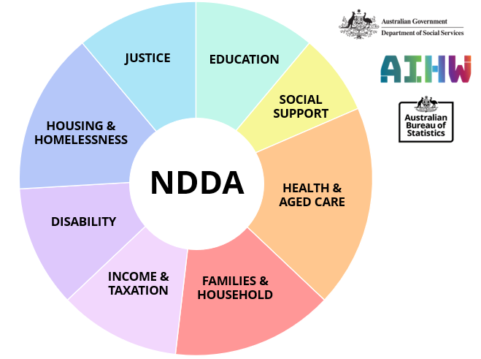
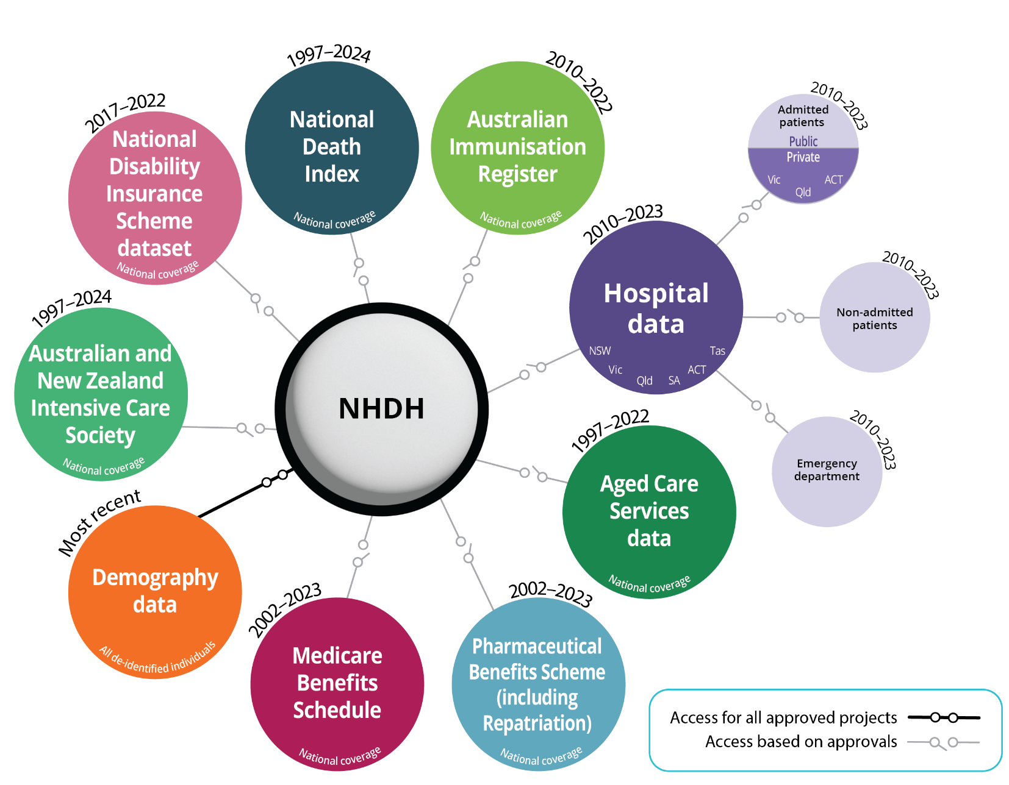
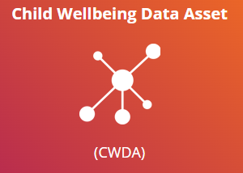


AIHW’s role in enabling external integration systems
NHDH Delivers
NHDH Supports
NHDH

Slide 20
Designing your research
Unlocking the power of linked
health and welfare data
for all Australians

Slide 21
Coverage of hospitals data
National Hospitals Data Collection (NHDC)
Non-admitted patient care
Admitted patient care
Emergency Department
NSW, Vic., Qld., Tas., ACT
NSW, Vic., Qld., Tas., ACT, SA
NSW, Vic., Qld., Tas., ACT, SA
Vic., Qld., ACT
Other NHDC datasets not in the NHDH
Public hospitals
Private hospitals
Data currently available from 2010-11 to 2022-23

Slide 22

Reference years of data
2010-11
2022-23
AIR, Most hospitals
2015-16
Chronic conditions data
1997-98
ANZICS (Paediatric 1997, Adult from 2017)
In 2025, all data is being released up to 2023-24
Pre-2010 data will be made available where possible
Upcoming releases:
      August
      November
2017-18
NDIS
2000-01
Aged care data
2002-03
MBS & PBS
1997-98
NDI

Slide 23
Who makes up the NHDH?
Linked
records
All people who are enrolled in Medicare
Unlinked episodes
Anyone who has interacted with the health, aged care or disability services in Australia:
International visitors
Migrants not eligible for Medicare scheme

Slide 24
Who makes up the NHDH?
AIHW’s Enhance Medicare Spine
Linked
records
Each linked person is given a NHDH PPN to enable linked population insights across datasets.
Unlinked episodes
For some datasets, a synthetic ID is used where it is known that episodes belong to the same person.
Help to understand population bias.

Slide 25
Generating insights for populations based on linked data
A diverse range of populations…
Circumstancial
Family and domestic violence
Conditions
Dementia
(younger onset, early diagnosis)
Hip fracture pathways
Pathways
Hospital to
Aged care
Cancer treatments and patient pathways
Traumatic brain injury
Palliative care
Suicide prevention
Last year of life

Slide 26
Applying for access
Unlocking the power of linked
health and welfare data
for all Australians

Slide 27
Governance of the NHDH
Overarching ethical approval
AIHW Act.
Privacy Act
15
Advises
Regulates
NHDH Governance Protocols
Informs
NHDH Advisory Committee
State and Territory & Commonwealth Department of Health representatives and National Disability Insurance Agency
AIHW NHDH
Data Custodian
AIHW Ethics
Secretary

Slide 28
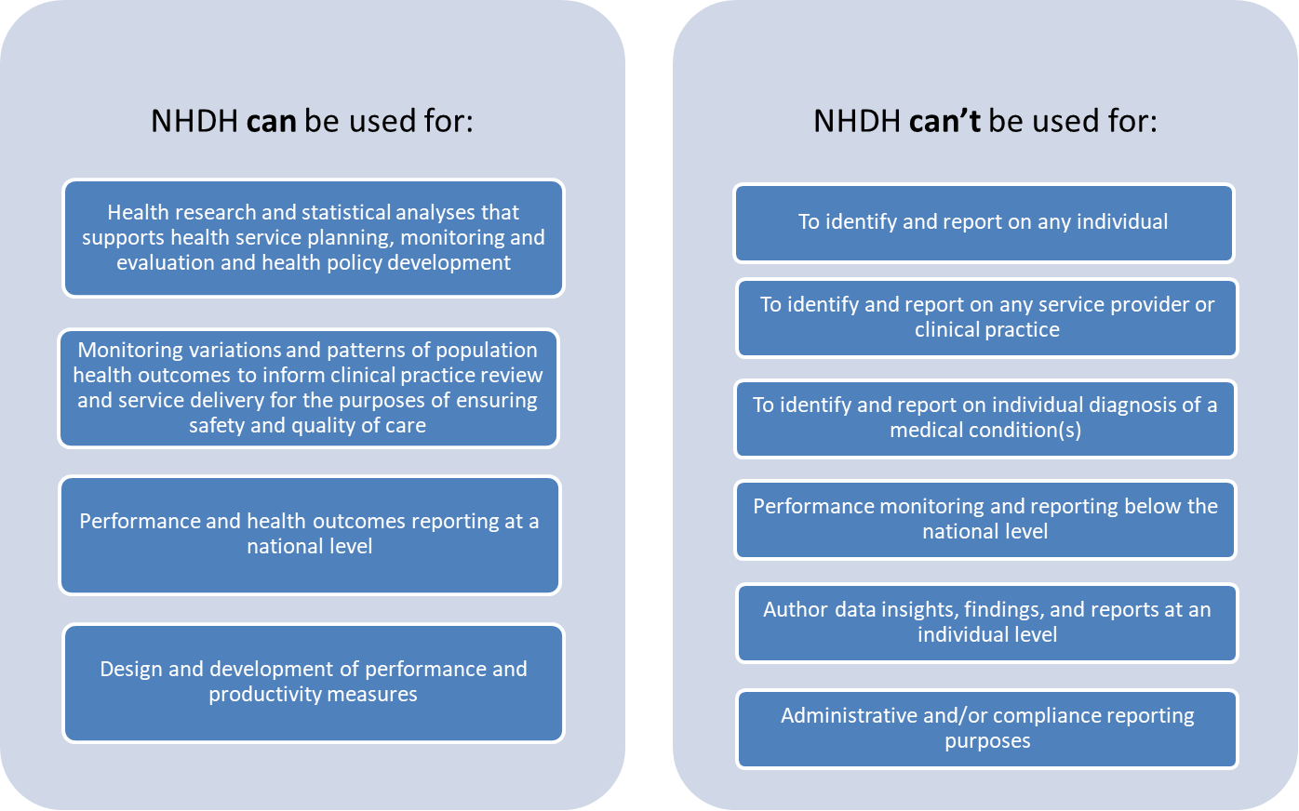
Current approved uses of NHDH

Slide 29
NHDH Governance – NHDH Advisory Committee
Access to these data modules is governed by the NHDH Advisory Committee

Slide 30
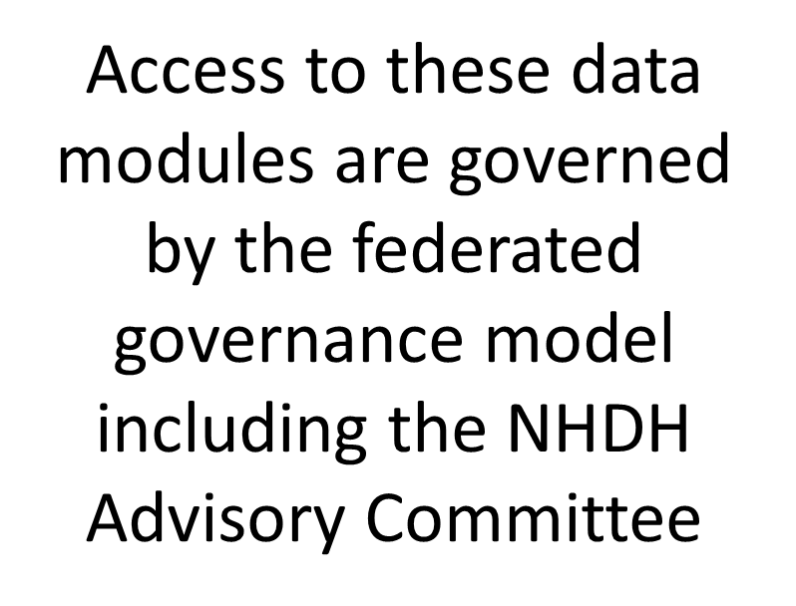
NHDH Governance – Federated model
Oversight via the Australian and New Zealand Intensive Care Society

Slide 31
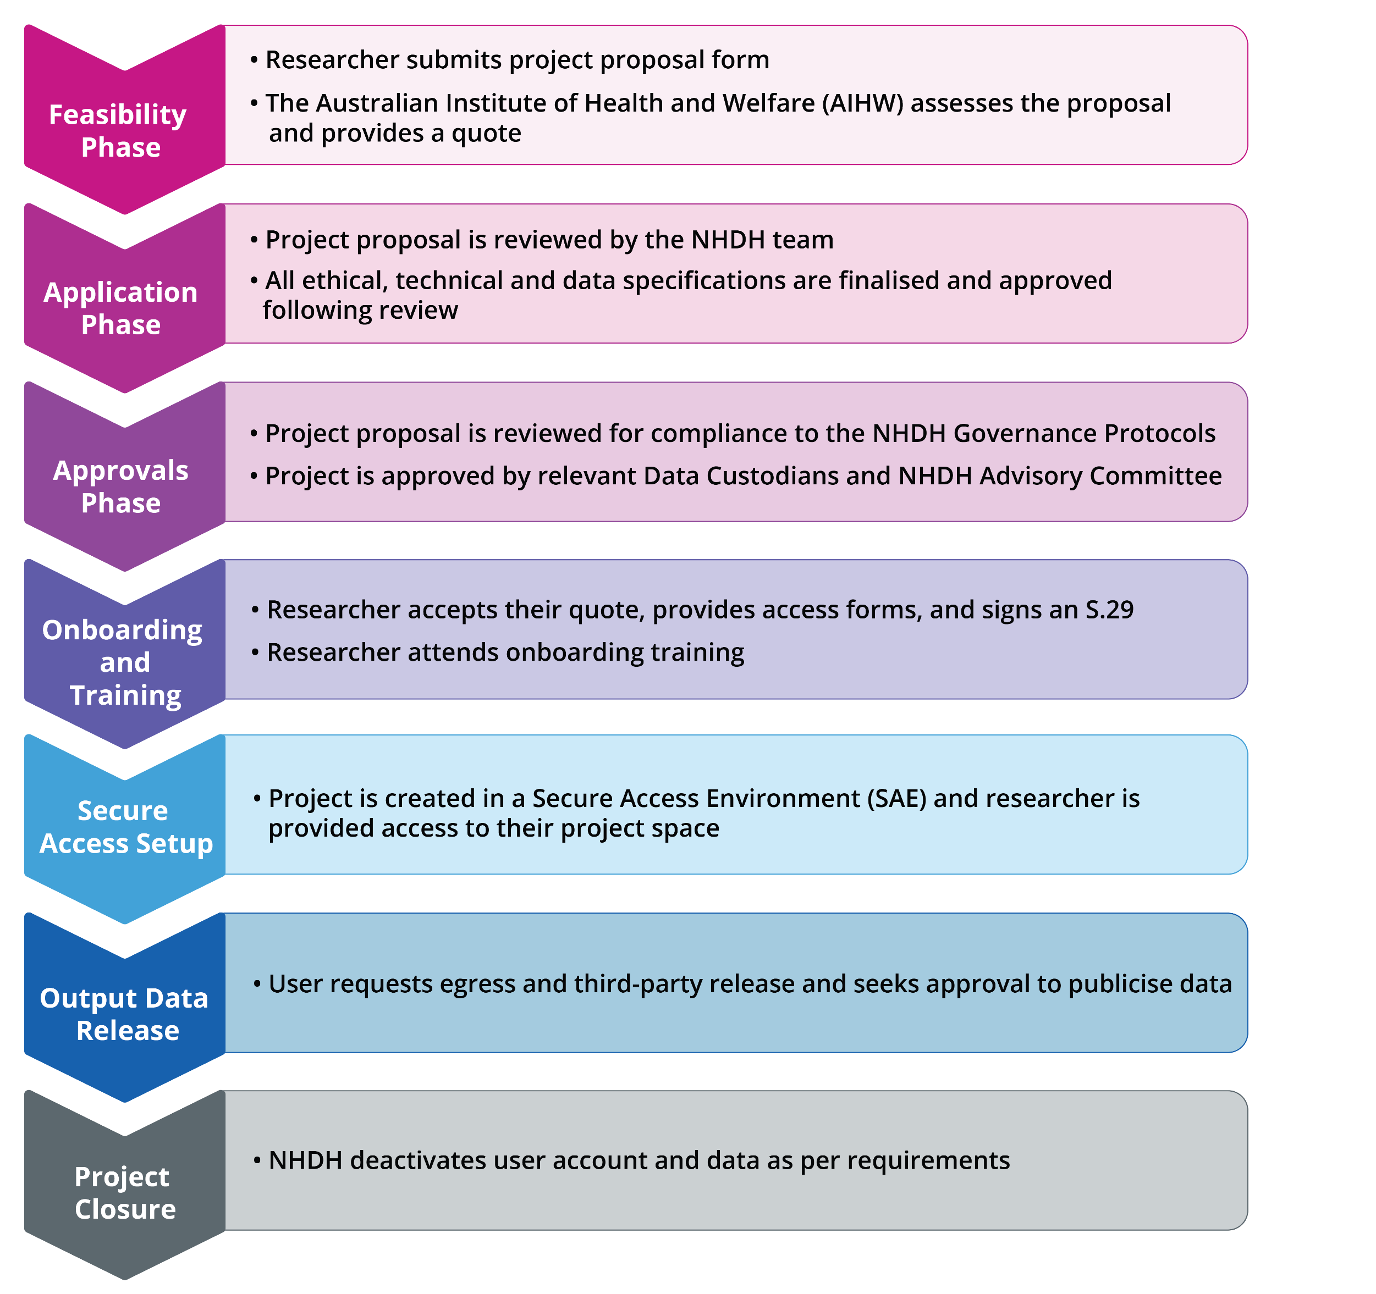
How to access the NHDH

Slide 32
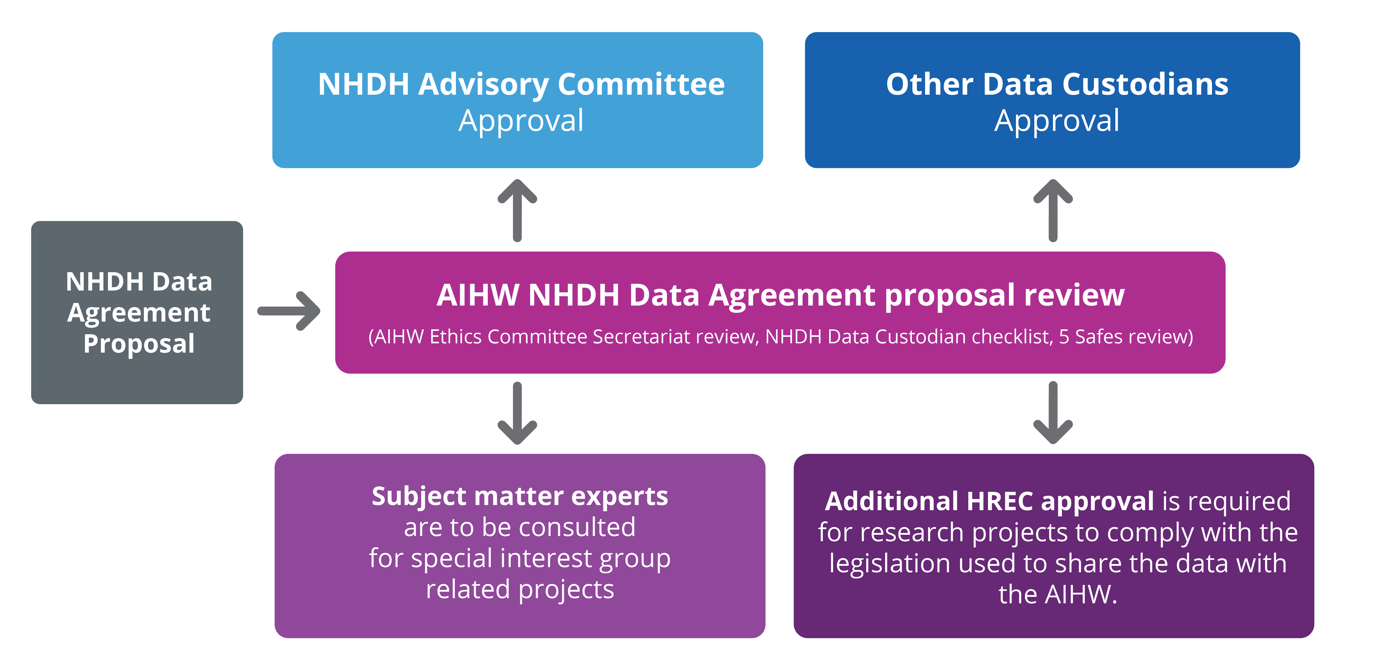
Project approvals process

Slide 33

Access to the NHDH
NHDH is available from:
    AIHW managed instance of the Secure
    Environment for Analysing Data (SEAD)
Standard software in SEAD includes:
    R
    Python
    Libre Office
Optional software in SEAD includes:
    SAS
    Stata
    Databricks*
*Databricks may be required for projects involving large-scale data analysis and complex methodology
Resources for researchers
    Data item lists
    Community of Practice
    User guides
    Cost model
    Website
NHDH website

Slide 34
The NHDH+n project model
Unlocking the power of linked
health and welfare data
for all Australians

Slide 35
What is the NHDH +n model?
What is NHDH +n?
The National Health Data Hub + n (NHDH+n) is a specific project model that allows researchers to enhance their project by linking additional, non-NHDH data collections to the NHDH on a project specific non-enduring basis.
Key Characteristics:
Supports cross-jurisdictional data integration
Centralised governance through AIHW NHDH pathways
Standardised metadata and linkage processes
Designed to reduce duplication and fragmentation
Built to scale with national public health priorities

Slide 36
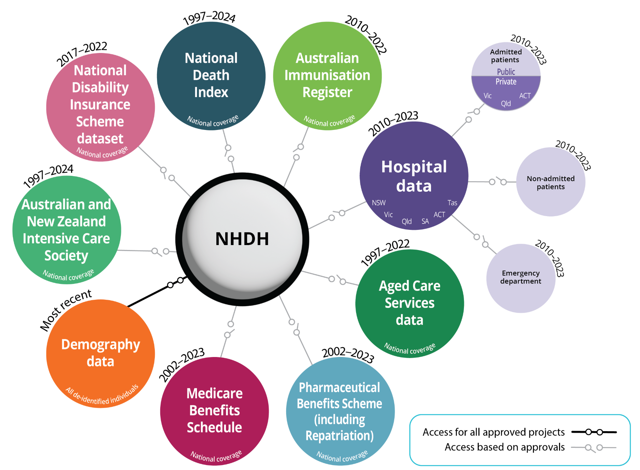
What does NHDH +n project model look like?
+ n
Dataset 1
Dataset 2
Dataset 3
Examples include:
Government administrative data not currently included in the NHDH
Additional years of data not currently included in the NHDH
Registries
Surveys
Cohort studies
Clinical trials

Slide 37
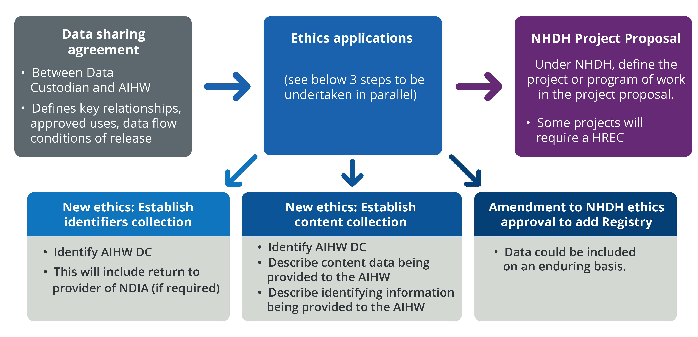
NHDH governance - Data sharing
*AIHW to lead these steps. This will formalise the data collections within AIHW via the APPs and in the AIHW Data Catalogue.
DC = data custodian

Slide 38
Collection, use and disclosure of identifiable data
Consent
Authorised by law exceptions to the Privacy Act 1988
AIHW is unable to collect, use or disclose sensitive personal information without consent of the individual about whom the information relates unless:
Waiver under Section 95 of the Privacy Act
Human Research Ethics Committee has granted a waiver under section 95 of the Privacy Act
Authorised by an Australian law or a court/tribunal order.

Slide 39
Emerging and future opportunities
Imaging
Pathology
Primary Care
Dental
Ambulance
Communicable disease data
Clinical Quality Registers, and clinical trial cohorts
Biobank and genomic sequencing data

Slide 40
NHDH enables insights and discovery of health utility and health pathways.
Analysis of linked data far surpasses what can be done with unlinked data
Relationships between Data Custodians is key
Identify early, the legal mechanism used to share data
Additional data can be linked to the NHDH via the NHDH+n program
Contact linkage@aihw.gov.au or nhdh@aihw.gov.au for more information.
Key messages

Slide 41

Questions?
Key Contacts:
NHDH@aihw.gov.au
Additional information:
https://www.aihw.gov.au/reports-data/nhdh
NHDH website

