Slide 1
New September 2020 SHIP data quality enhancements
Specialist Homelessness Services Collection

Slide 2
Home
This information pack provides information about new data quality enhancements for the Notes tab and additional extract validation in SHIP. It includes the following sections:
Overview of new data quality enhancements
Why changes are being made
What changes are being made
What is a SHS service
New edits
Updates to the monthly extract process
Resolving errors on Missing Records tab
Non-SHS services tab
What happens to new and existing Notes on 1 September 2020?

Slide 3
Overview of Notes data quality enhancements
Notes data quality enhancements released on 1 September 2020 will:
Ensure that support periods are created for everyone who is selected as receiving SHS services
Ensure services are recorded
Confirm that other clients associated in a Note have all received the same SHS services
Implement validation to prevent generation of monthly extracts until errors recording SHS Services have been resolved.

Slide 4
Why changes are being made
These changes are being made to improve the quality of the data in the Specialist Homelessness Services (SHS) Collection.
The AIHW has identified that there are a significant number of instances where services provided by agencies are recorded for people who do not have a corresponding support period.
In such cases, this service information is not reported in the SHS Collection. This may mean that the work of agencies is being under-reported.

Slide 5
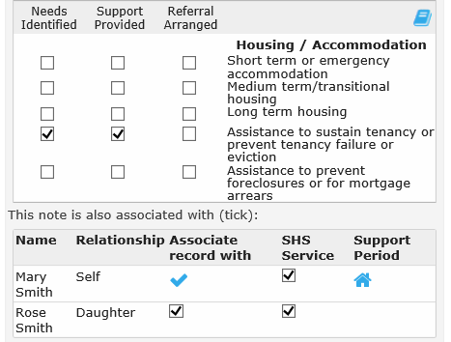
What changes are being made
Updates to the Notes tab:
New SHS Service checkbox:
  Indicates that client received a SHS service.
  Services will be included in the monthly extract when ticked.
New Support Period indicator:
  ‘House’ icon indicates that the client currently has an open support period.

Slide 6
What is a SHS service
What is an SHS service:
Any service provided by an SHS agency with the intention of responding to, or preventing, homelessness for a client.
People receiving a SHS service must have an open support period.
What is not an SHS service:
Services provided to individuals which are funded through programs outside of the scope of the SHS Collection.
These services do not have to relate to a support period.

Slide 7
New edits
There are 3 new edits that have been applied to the Notes tab.
Check that at least one service has been recorded.
Check that SHS services are only recorded for a person with an open support period.
Check that SHS services associated with other members of the presenting unit / household were actually provided to those people.
These edits will apply to any Note created from 1 September onwards. This includes Notes created from this date and backdated to a previous month.
The messages and advice on how to resolve the issues are detailed on the following pages.

Slide 8
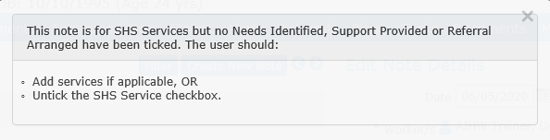
New edits – no SHS services recorded
This message appears when the SHS Services checkbox is ticked but no services have been selected.
If this message appears you will not be able to save the Note until the issue is resolved.
To resolve this issue, either:
  Record a service provided to the person
  OR
  Untick the SHS Services checkbox – this would be the solution if the Note only contained information for agency staff and did not relate to any services provided to the client, e.g. a record of a missed appointment.

Slide 9
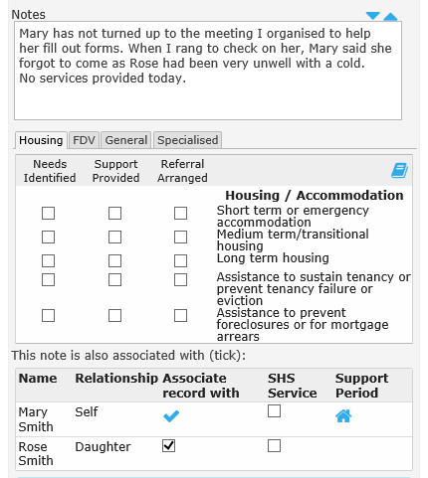
New edits – no SHS services recorded
Example of error message – no SHS services selected:
Shows case where no SHS services have been provided.
SHS Service checkbox is unticked to resolve the error.
Note is entered to record case management information only.

Slide 10
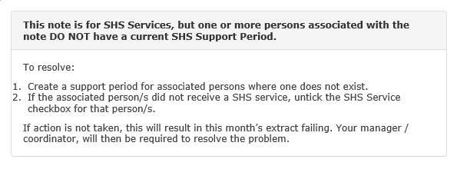
New edits – SHS services must relate to a support period
This message appears when the Note indicates a SHS service is provided and has been associated with a person who does not have a current support period.
  People ‘associated with this Note’ will have a tick in the ‘Associate record with’ column.
  Whether that person has a support period or not is shown in the ‘Support Period’ column – a ‘house’ indicates an open support period.
Important: for Notes that are backdated, the Support Period Indicator may not display the correct information until the Note is saved.
This edit will not stop the Note being saved, however, it MUST be resolved before the monthly extract can be generated.

Slide 11
New edits – SHS services must relate to a support period
To resolve this message:
If this message occurs because you have forgotten to create a support period for the person then you need to create a support period for this person or add them to the support period for another member of the presenting unit that already exists.
If this message occurs because the service was associated with someone who did not receive this service directly then you should either:
  Untick the ‘Associate record with’ column for this person, or
  Untick the SHS Service checkbox for this person.
If a person is receiving a service that is funded via a source other than SHS funding then the agency worker should untick the SHS Services for that person.

Slide 12
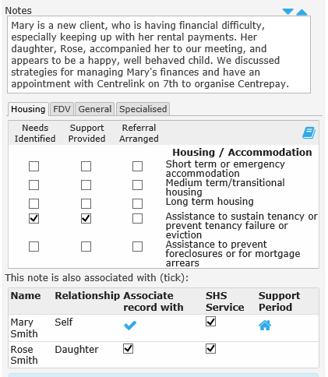
New edits – SHS services must relate to a support period
Example of resolving error message:
Associated person (daughter) does not have a support period (no ‘house’ icon).
Daughter is not directly receiving support.
Untick the ‘Associate record with’ for the daughter OR
Untick the daughter’s ‘SHS Service’ checkbox to resolve the error.

Slide 13
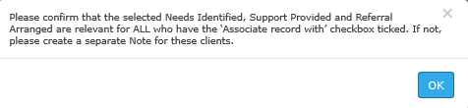
New edits - Confirmation that all people associated with Note are receiving all services
This message occurs whenever a Note is associated with someone else in the family or in the presenting unit. It is to ensure that Notes are not automatically being associated with all members of the presenting unit without ensuring that all the people actually received all the services.
SHSC data shows that some young children are reported as receiving services that are not appropriate to someone of their age, for example, employment assistance. This is likely to occur if a child is associated with a Note that relates to services provided to the mother.
This message is only a warning. It will not stop the Note being saved or result in any issues when the monthly extract is created.

Slide 14
New edits - Confirmation that all people associated with Note are receiving all services
Resolving this message depends upon the situation:
If all people are receiving all services listed, then no action is required.
If the services were provided to one person and other people only benefitted indirectly (i.e. other people did not receive a direct service), then untick the ‘Associate record with’ column for the other person(s).
If all services were provided to one person and only some of the services were provided to the other person(s) then untick the ‘Associate record with’ column for the other person(s). A separate Note needs to be created for the other person(s) which only includes the actual services they received.
If some services were provided to one person and other services were provided to the other person(s) then untick the ‘Associate record with’ column for the other person(s). Amend the services to ensure they reflect the services provided to the person for whom the Note was created. A separate Note needs to be created for the other person(s) which only includes the actual services they received.

Slide 15
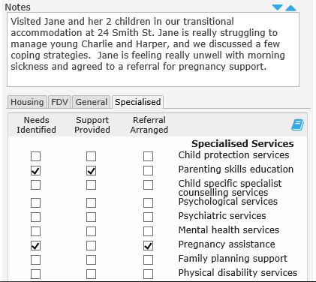
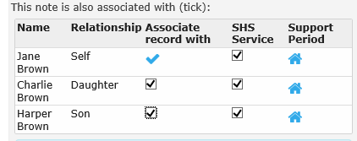
New edits - Confirmation that all people associated with Note are receiving all services
Example:
This is a case where it would be incorrect to associate this Note with the children.
Children did not receive the services provided and referred for their mother.
To resolve, untick the ‘Associate record with’ checkbox for the children. This will also automatically untick the ‘SHS Service’ checkbox for the children.

Slide 16
Updates to the monthly extract process
New validation
New validation has been added to the extract process. This ensures that an extract cannot be created if a client has received a SHS service, as identified in a Note, and that service IS NOT associated with a support period.
  This occurs when no action was taken when the message shown below appeared as a warning when the Note was created.
This validation applies to all extracts created from 1 September 2020 onwards. This includes extracts for previous months created from 1 September 2020.

Slide 17
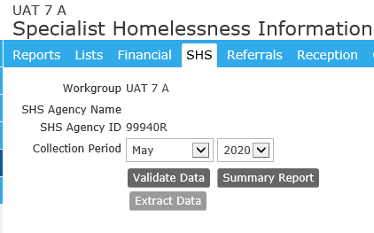
Updates to the monthly extract process
Updates to the Reports>SHS tab
If any Note has a SHS service recorded that is NOT associated with a support period then it will not be possible to run an extract for that month.
The ‘Extract Data’ button is ‘greyed out’ until this is resolved for all records.

Slide 18
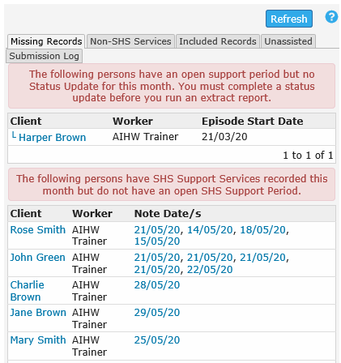
Updates to the monthly extract process
Updates to the Reports>SHS tab
A new section has been added to the ‘Missing Records’ tab.
This displays a list of persons with SHS Service checkbox ticked where this service is not related to an open support period.
Extract cannot be generated until all records in this list are fixed.

Slide 19
Resolving errors on Missing Records tab
Click Refresh to update list
Steps to resolve Missing Records errors:
Click on the note date hyperlink to go to the person’s Note to investigate the error.
Note will open in a new browser tab.
Click on ‘Edit Services’ to enter locked note.
Save the record to see which error message is displayed.
Take action to resolve the error.
Return to Missing Records tab and click on ‘Refresh’ to update list of remaining errors.
Click hyperlink
to go to Note

Slide 20
Resolving errors on Missing Records tab
Example #1– Person has no support period:
Multiple notes for a person may indicate a support period is required.
In this example, check the case note history for John Green to see if SHS services were directly received.
Confirm services received with case worker.
A support period should be opened on date when first SHS service was provided.

Slide 21
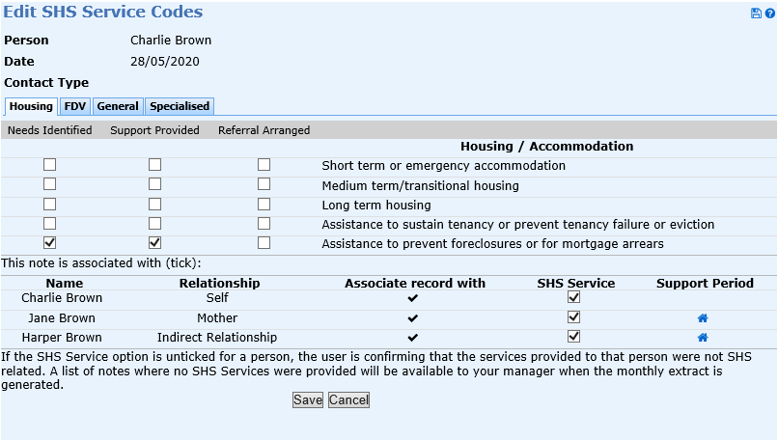
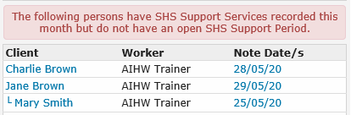
Resolving errors on Missing Records tab
Example #2 – person did not directly receive SHS services:
In this example, Charlie Brown did not directly receive SHS services.
Follow link to note and click on ‘Edit Services’.
Untick the SHS Service checkbox next to Charlie’s record.
Note: Charlie’s record does not have a support period ‘house’ icon

Slide 22
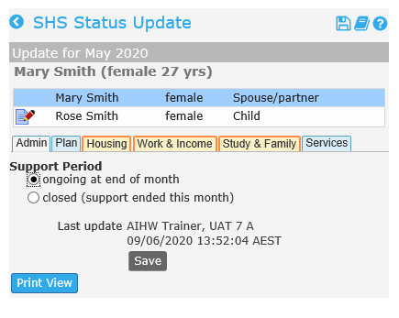
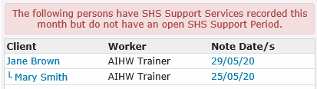
Resolving errors on Missing Records tab
Example #3 – Note added after support period was closed:
In this example, Mary Smith had a support period, but one of the notes is dated after the support period was closed
To resolve, go to Status Update Admin tab and change from ‘closed’ to ‘ongoing’, then ‘Save’.
This re-opens the support period to include this note.

Slide 23
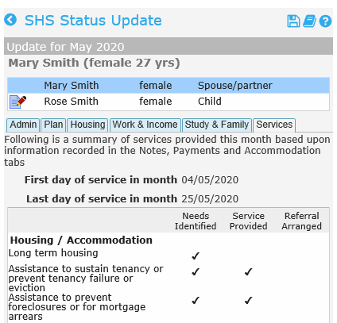
Resolving errors on Missing Records tab
Example #3: Note added after support period was closed continued:
Go to Status Update>Services tab to check date of note is included.
Go to Admin tab and re-close the support period.
Return to Reports>SHS and refresh the list of Missing Records.

Slide 24
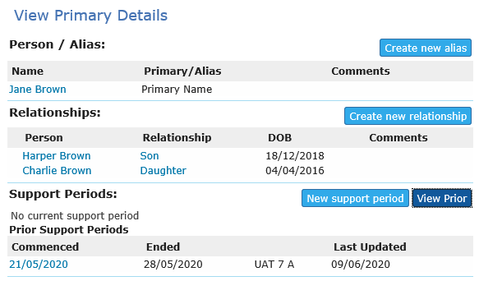

Resolving errors on Missing Records tab
Example #4 – Note added before support period start date:
In this example, Jane Brown had a support period, but one of the notes is dated before the support period opened.
Check Support period start date on Client Details tab.
To resolve this error, change date of Note, or support period start date.

Slide 25
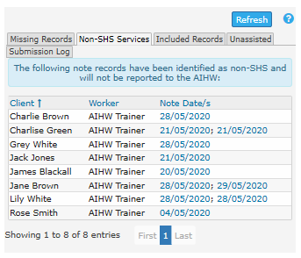
Non-SHS Services tab
New Non-SHS Services tab:
New tab next to the Missing Records tab on Reports>SHS page
Lists all notes in which the SHS Service flag has been ‘un-ticked’ for that person.
Notes listed on this tab will not prevent an extract being generated.
Managers can review list to ensure that case workers are not incorrectly removing the flag from any SHS services that should be included in the monthly extract.

Slide 26
What happens to new and existing Notes on 1 September 2020?
Pre-existing Notes as at 1 September
Notes created prior to 1 September will not prevent the creation of extracts.
The ‘SHS Service’ checkbox will be ticked in Notes for people with support periods at that time.
The ‘SHS Service’ checkbox will be unticked in Notes for people who did not have a support period at that time.
New Notes created 1 September onwards
Each new Note created from this time will be subject to the new checks listed in this document.
Notes created from this time and backdated to previous months will also be subject to these new checks, irrespective of when they are backdated to.

